Slide 1










An Introduction to AI in Training and Education
Chris Farrell
Learning and Organisational Development Specialist
27th May 2025

Slide 2

Welcome

Slide 3


Agenda
10.00 – 10.15
10.15 – 10.45
10.45 – 11.15
11.15 – 11.30
11.30 – 12.00
What is AI?
Examples of AI Tools and Capabilities
Learning with Technology
Ethics and Challenges
Project Work

Slide 4
Icebreaker
What comes to mind when you hear 'AI'?

Slide 5


1.
What is AI?

Slide 6
"Artificial Intelligence is about getting computers to behave in ways that, until recently, we thought required human intelligence.“
Professor Alan Smeaton

Slide 7


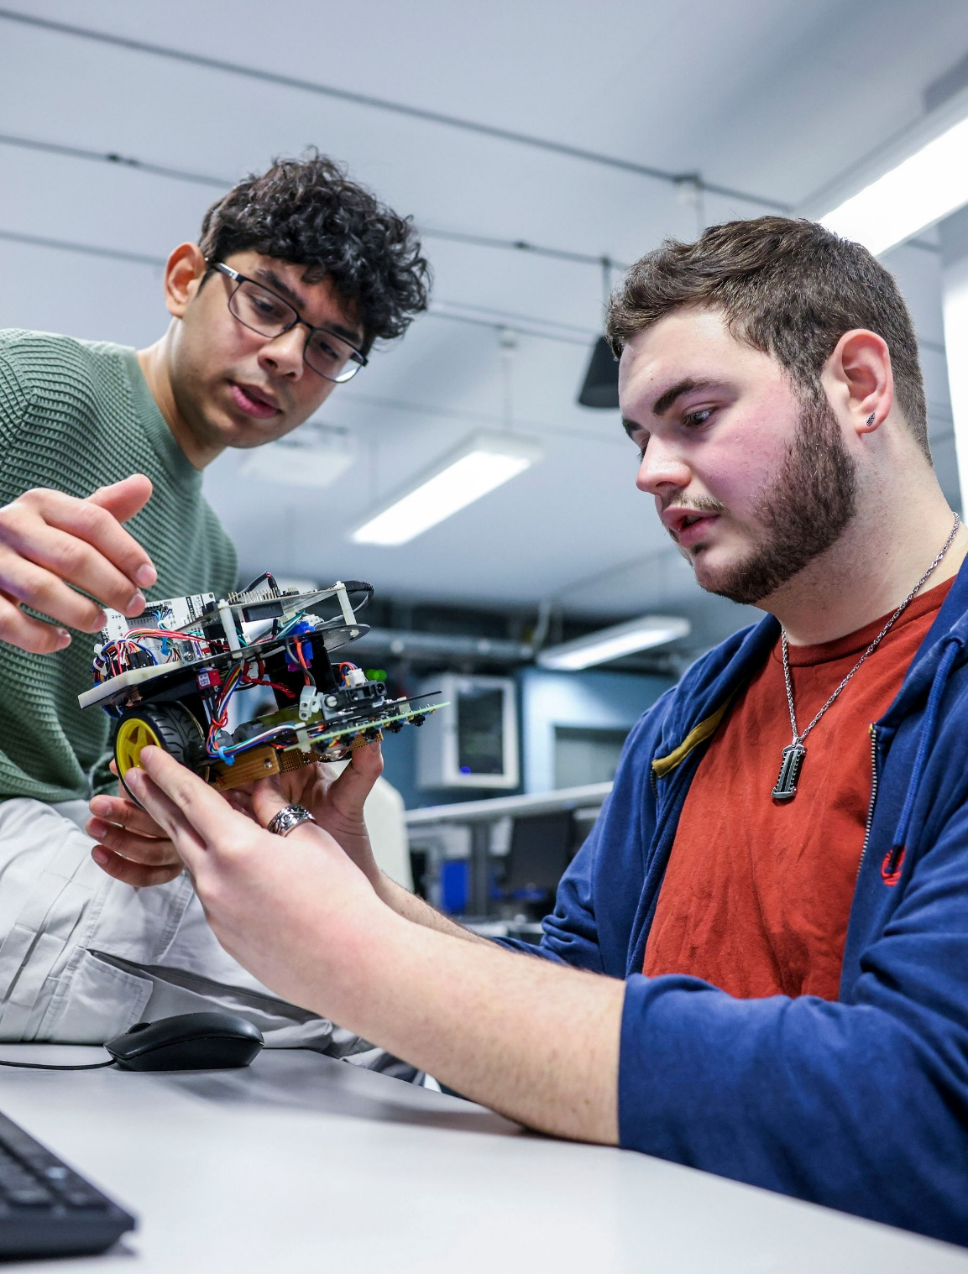

What is Artificial Intelligence?
🤖 Simulate | Machines mimic human thinking
📚 Learn | Systems improve through data
⚡ Assist | AI automates and personalizes tasks

Slide 8
Types
Everyday Examples
Narrow AI
(today's AI like ChatGPT)
General AI
(Human-level thinking (still theoretical)
Machine Learning as a subset (improves by learning from data)
Maps suggesting faster routes
Netflix recommending shows
Voice assistants (Siri, Alexa)

Slide 9
What’s Happening?
“We have a very good idea of sort of roughly what it's doing but we don't actually know what's going on anymore than we know what's going on in your brain. We designed the learning algorithm...but we don't really understand exactly how they do those things.”
Geoffrey Hinton
Computer & Cognitive Scientist

Slide 10
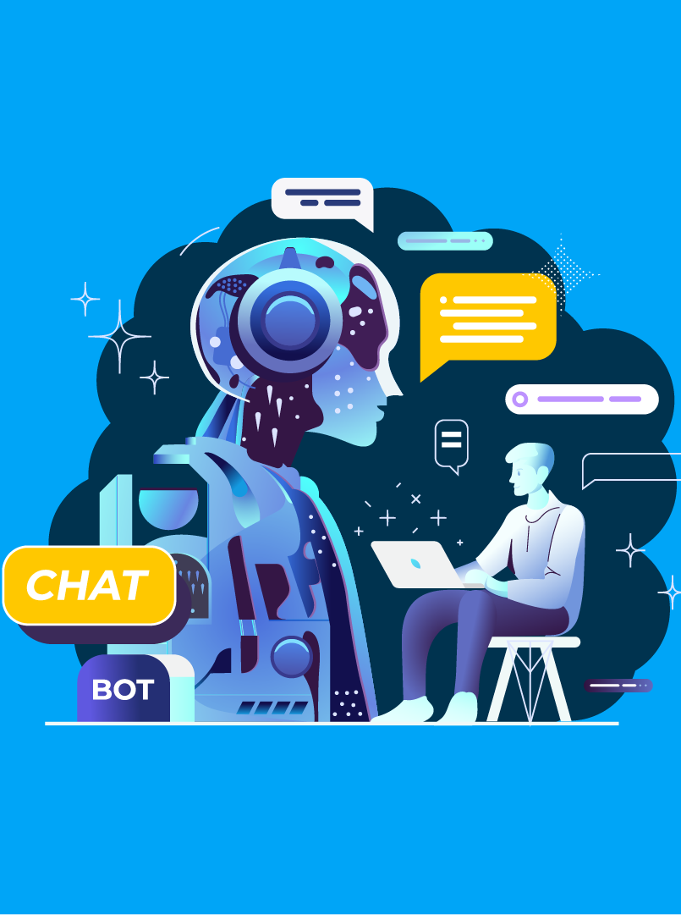
2. Examples of AI Tools

Slide 11
Category | Examples | What They Do
Chatbots & Information Assistants | ChatGPT, Perplexity AI | Generate text, answer questions, assist with writing, and research.
Educational AI Tools | Duolingo (AI features), Khanmigo (Khan Academy) | Personalize learning, tutor students, guide practice activities.
Writing & Editing Support | Grammarly, Quillbot | Improve grammar, clarity, tone, and style of written communication.
Creative AI (Art and Media) | DALL-E, Canva AI | Generate images from text, assist in designing creative content.
Productivity & Workplace AI | Microsoft Copilot, Notion AI | Summarize notes, draft documents, automate everyday work tasks.

Slide 12
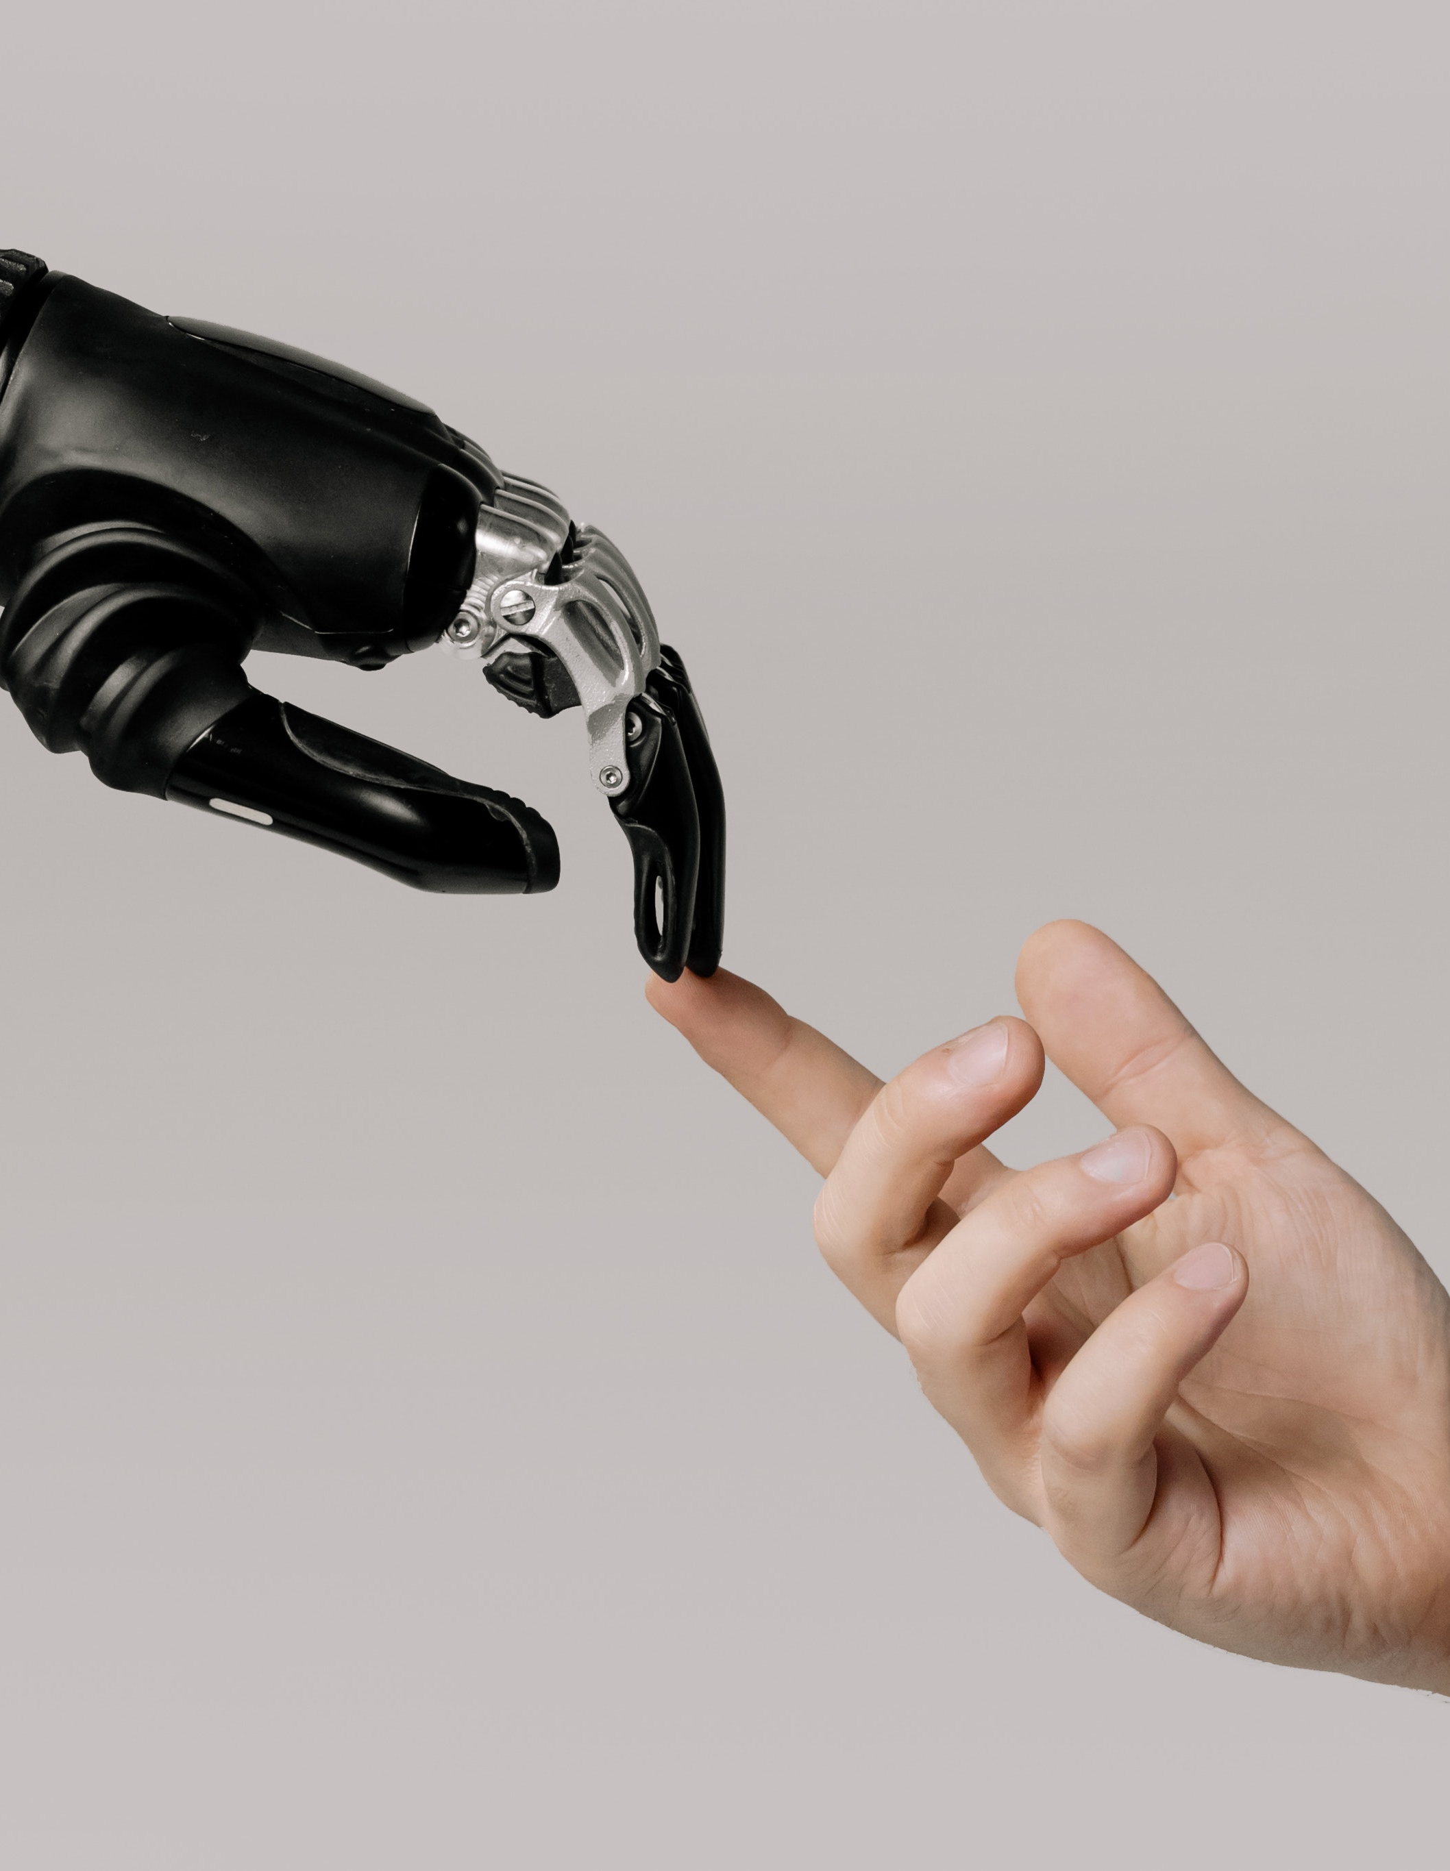
3.
Learning with Technology

Slide 13

How AI Enhances Learning
H
Personalized Learning
Content and pace fit individual needs, boosting engagement and outcomes
Skill Gap Analysis
Identification of what learners’ need with supports suggested
Smart Content Delivery
Automated creation and adaptation of materials in multiple formats

Slide 14

How AI Enhances Learning
H
Gamification & Interactivity
Games and simulations for immersive learning experiences.
Teacher Support
Automates admin tasks, allowing more time for personal interaction
Real-World Examples
Kahoot! for gamified quizzes, Quizizz for adaptive questions, AI chatbots for student support.

Slide 15

4.
Ethics and Challenges

Slide 16

Key Ethical Challenges
Bias and Fairness
Privacy and Data Security
Transparency & Accountability
Academic Integrity
Accessibility & Equity
Human Element

Slide 17

5.
Practicalities

Slide 18
Prompting
AI as a Writing Partner
AI for Producing Documents

Slide 19


Group Work
1. Comparing ChatGPT, Gemini, and Claude
2. Asking for support on Prompting
3. Creating a Document
4. Discussing Positives and Negatives

Slide 20

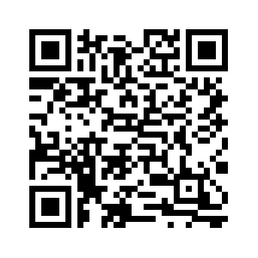
Thank
you
Chris Farrell Learning and Organisational Development Specialist

