Slide 1
PPN Summer School: EDI Talk
Dr Tanya Ní Mhuirthile,
Associate Professor, School of Law & Government

Slide 2
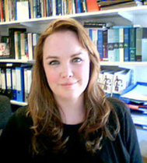
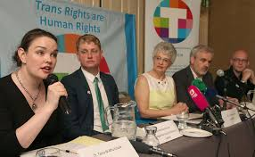
Who am I?
Academic: law’s interaction with the human body
Activist: Use my research to assist NGOs and other activists to advocate for legal change
Advisor: advise government ministers; politicians, civil and public servants and international organisations on drafting of legislation and policy:
Impact:
Criminal Justice (Female Genital Mutilation) Act 2012
Gender Recognition Act 2015
Appointed to Gender Recognition Act Review Group, November 2017
Member of Drafting Committee for Council of Europe Intersex Recommendation

Slide 3
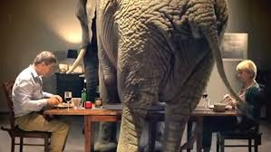
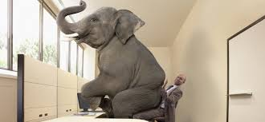
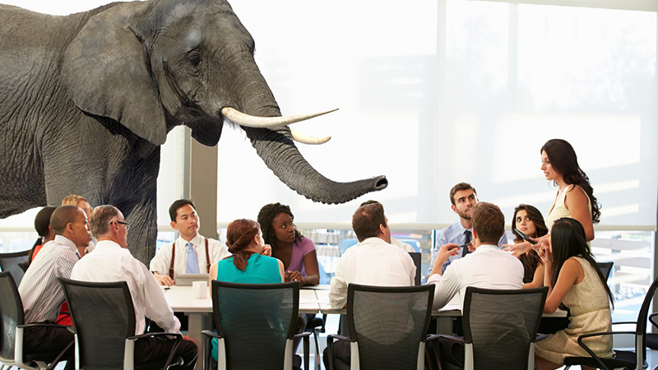
What is an inclusive workplace?

Slide 4
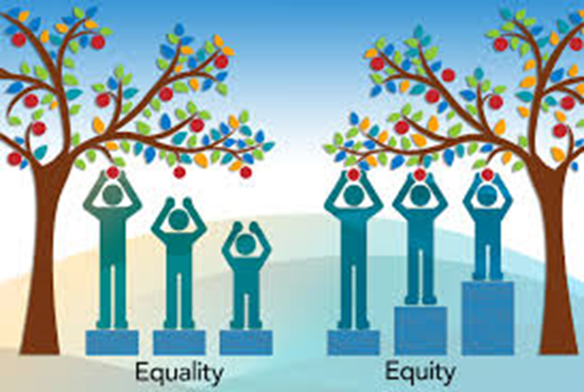
Equity not Equality
“Equity is trying to understand where people are coming from and give them what they need to be successful”

Slide 5
Sites of Exclusion
Age
Gender
Family
Ability
Ethnicity
Sexuality
Faith

Slide 6
Creating an Inclusive Environment
Policies
Physical Environment
Culture

Slide 7
Policy: HR Toolkit
Policy
Role of Manager
Access to Forms
Common Queries
Terms
Info Sources
Contact Details
Engagement

Slide 8
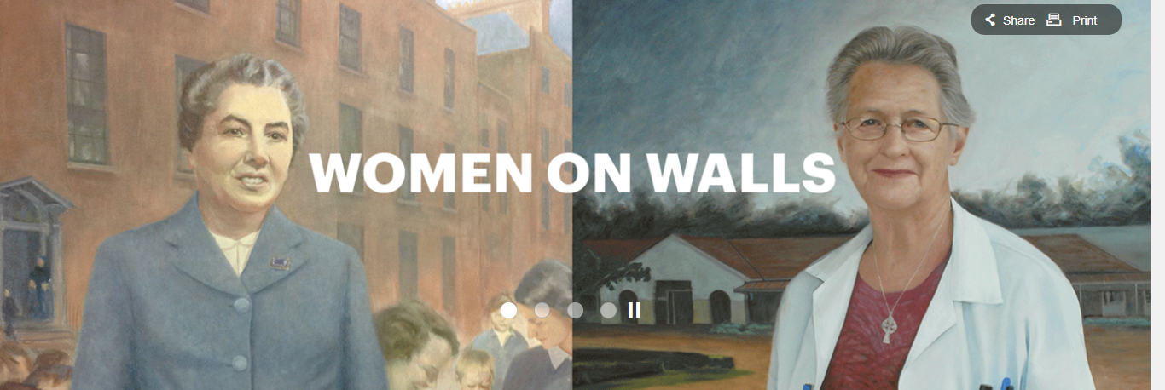
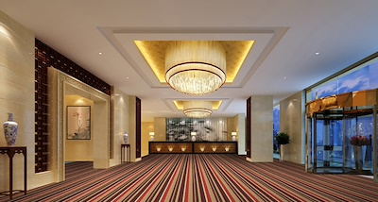
Physical Environment
@tanyanim

Slide 9
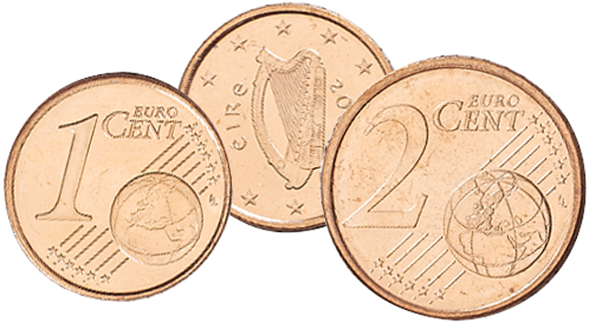
Culture

Slide 10
Faith

Slide 11
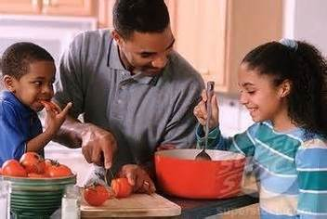
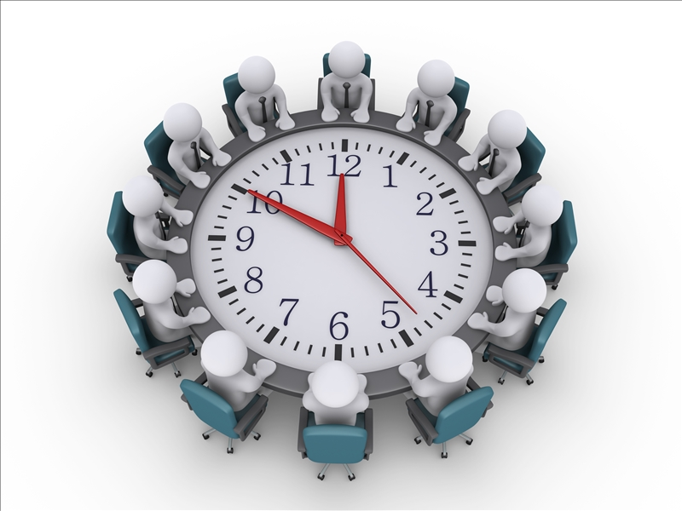
Family

Slide 12
LGBTTTTTIQQAAAAANB2SdsR
Sexuality
Sex Identity Orientation Expression

Slide 13
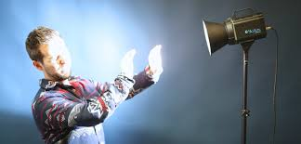
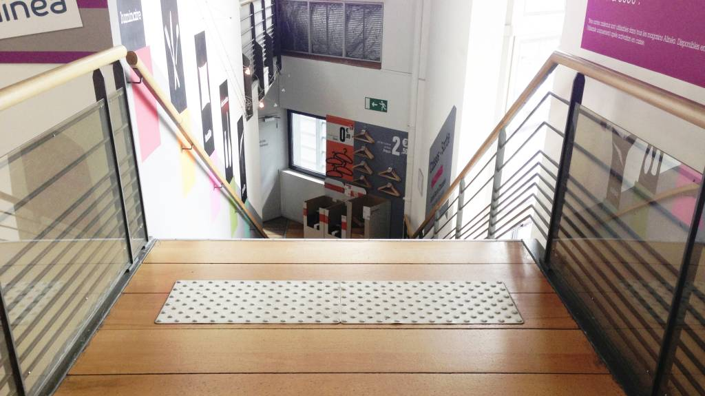
Ability
@tanyanim

Slide 14
Unconscious Bias

Slide 15
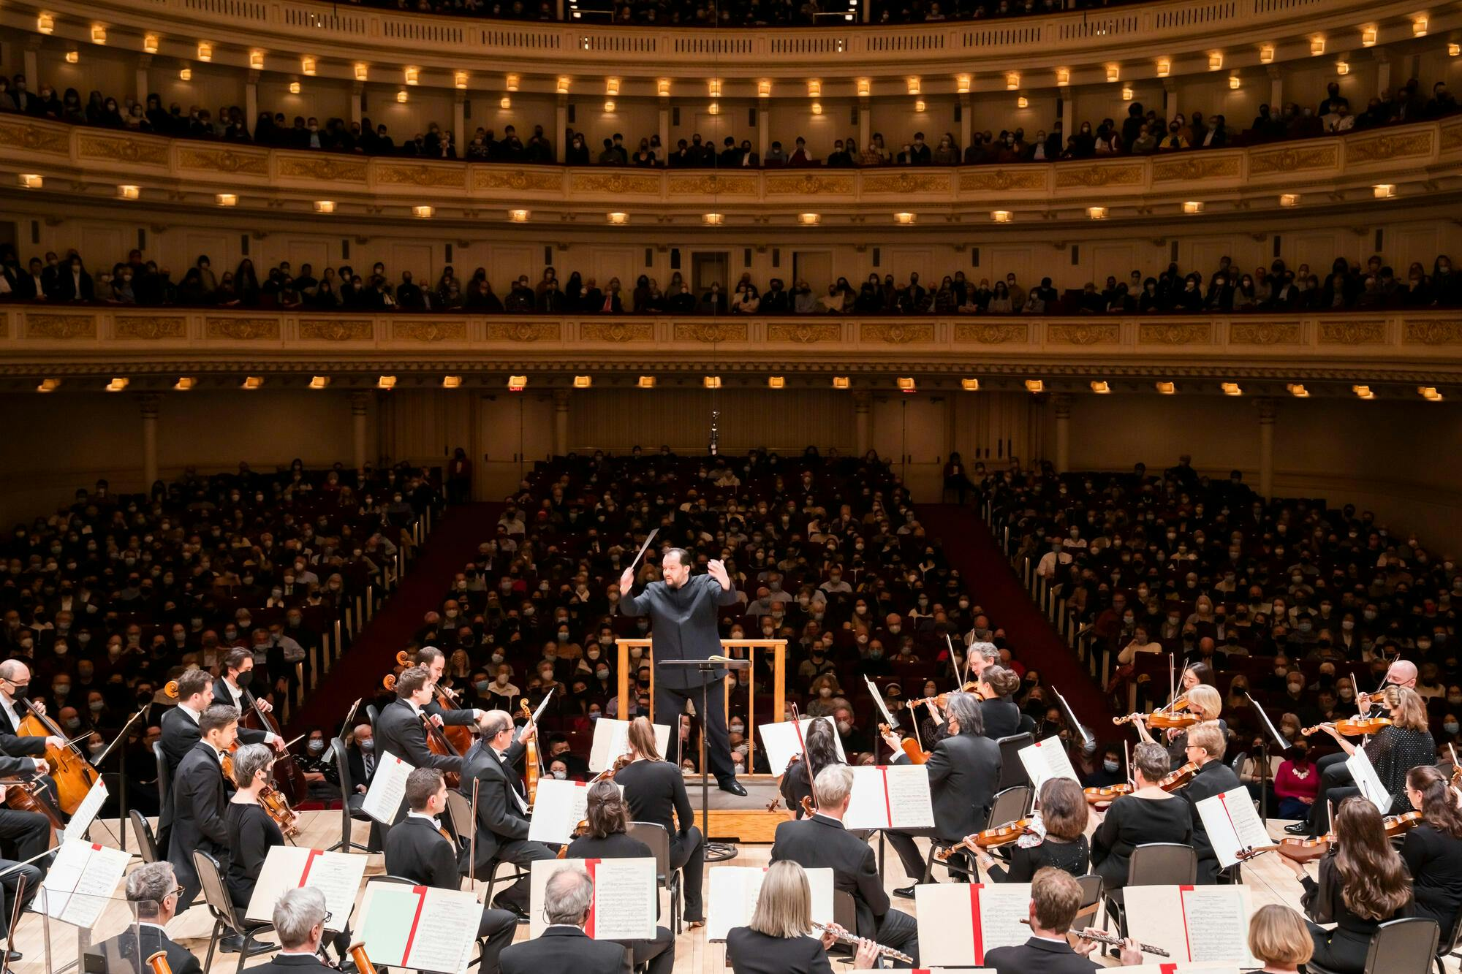
Unconscious Bias

Slide 16
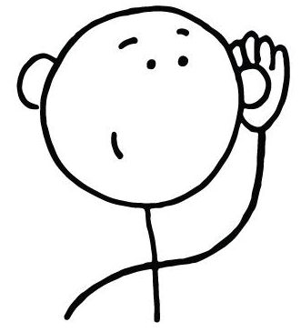
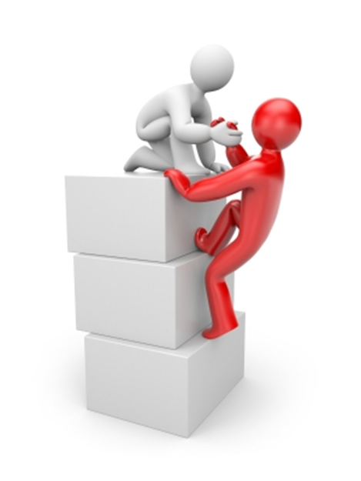
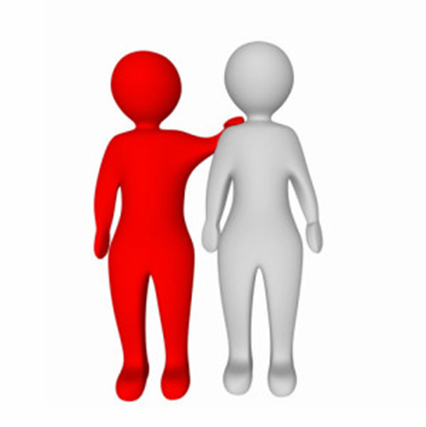
Top 5 Tips for an Ally
2. Listen & Do Your Homework
3. Speak Up Not Over
1. Know Your Privilege
4. You’ll make mistakes - apologise
5. Ally is a verb

Slide 17
Take Home Messages
Strive for equity not equality
Policy – think PRACTICE
Environment – think about the messages your physical spaces send
Culture – think about small changes & ally programmes

Slide 18
Contact Me:
tanya.nimhuirthile@dcu.ie
(01) 700 5626
Dr. Tanya Ní Mhuirthile,
Associate Professor of Law,
School of Law and Government,
DCU, Glasnevin, Dublin 9

