Slide 1
The Sustainable Development Goals – Closer than You Thought!
Public Participation Network - Dublin City University Summer School 2024
Notes:
What is Dev Ed
What is Global Citizenship Education
What are the SDGs
How to make participation for the Goals meaningful
County Development Plans
Mentimeter

Slide 2
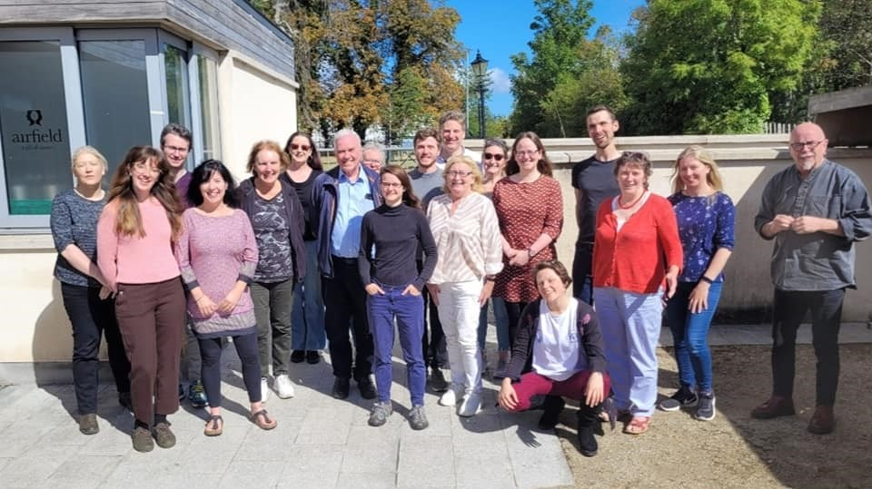
Saolta is a Global Citizenship Education (GCE) strategic partnership programme for the Adult and Community Education sector in Ireland between Irish Aid and a consortium of organisations.
Strategic Goal:
Increase accessibility, quality and effectiveness of GCE within the Adult and Community Education sector.
Further Education Institutions
Training of
Trainers
Local Authorities & Public Participation Networks (PPNs)
Global
South
Engagement
The Global
Compass Award
Research & Resources
Facebook: https://www.facebook.com/saolta.ed
Twitter: https://twitter.com/SaoltaEd
Instagram: https://www.instagram.com/saolta.ed
Website: https://saolta.com/

Slide 3
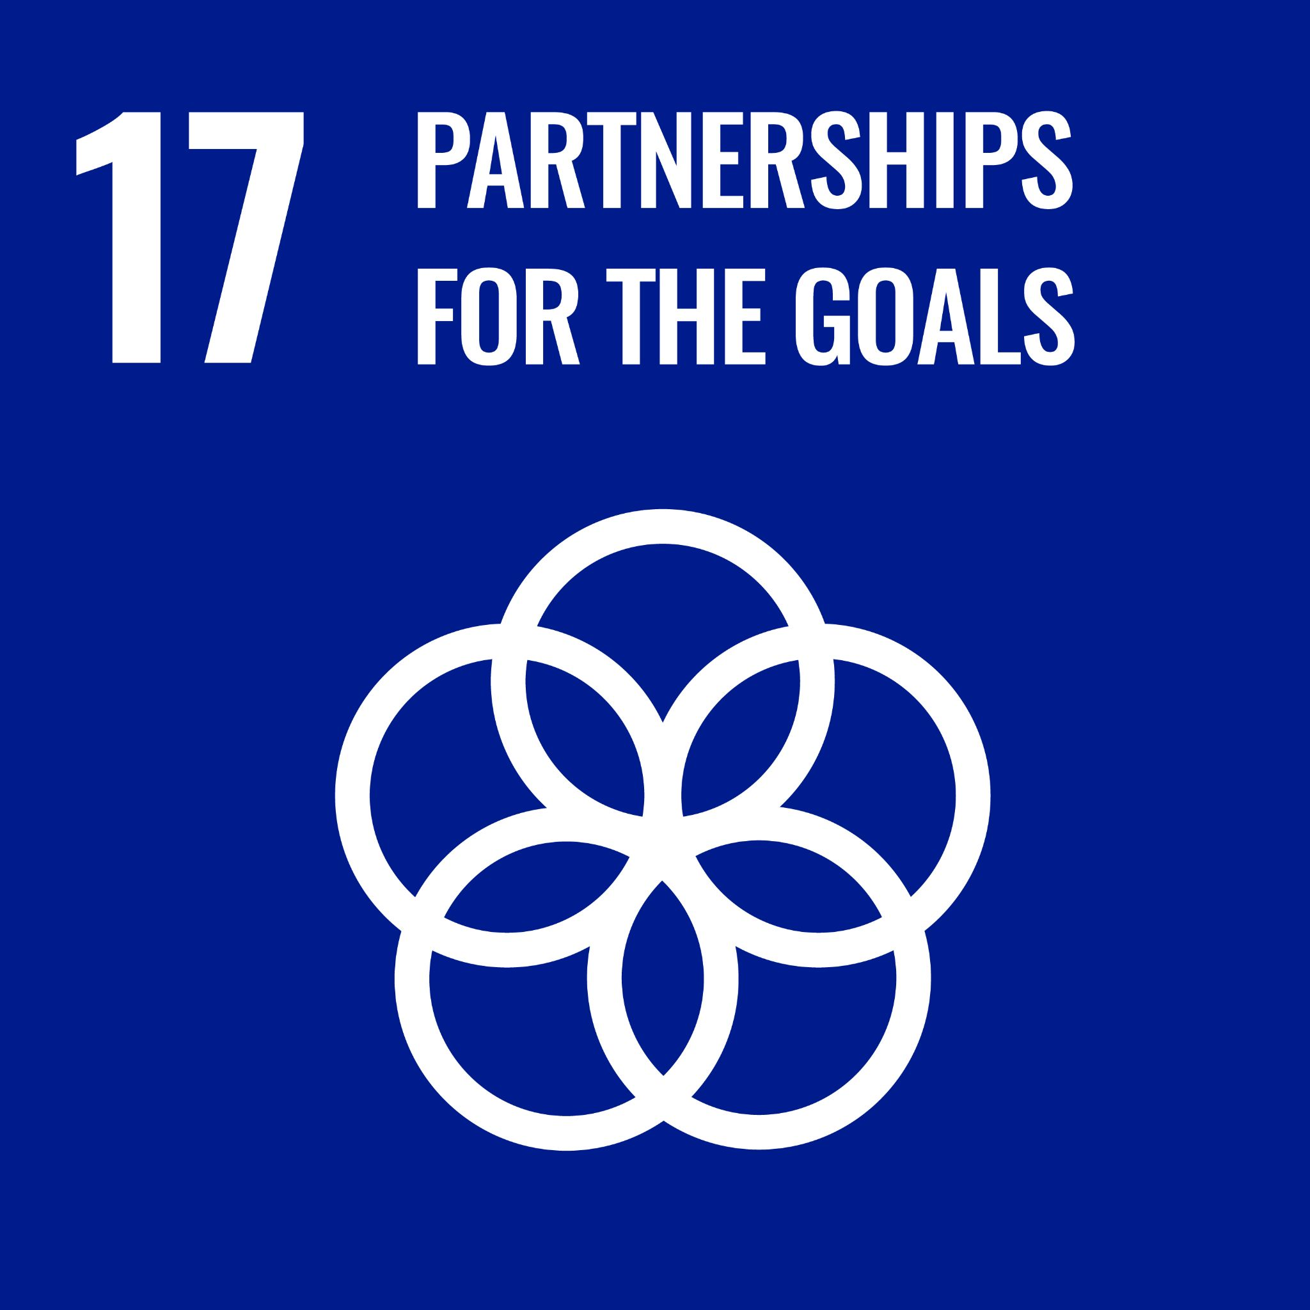
Agenda
Introductions
Global Citizenship Education (GCE)
The Sustainable Development Goals (SDGs) and Development Issues
Digging deeper
Resources
Notes:
Dóchas Guide on Ethical Communications

Slide 4
Let’s do a Check-in!

Slide 5
Global Citizenship Education (GCE)
There are many definitions of GCE:
UNESCO: Global Citizenship Education aims to empower learners of all ages to assume active roles, both locally and globally, in building more peaceful, tolerant, inclusive and secure societies.
Irish Aid: defines it as a lifelong educational process, which aims to increase public awareness and understanding of the rapidly changing, interdependent and unequal world in which we live. By challenging stereotypes and encouraging independent thinking, GCE helps people to critically explore how global justice issues interlink with their everyday lives and how they can act to build a better world.
Notes:
Global Citizenship Education is an active and creative educational process to increase awareness and understanding of the world we live in. It challenges perceptions and stereotypes by encouraging optimism, participation and action for a just world (Trócaire, 2017).

Slide 6
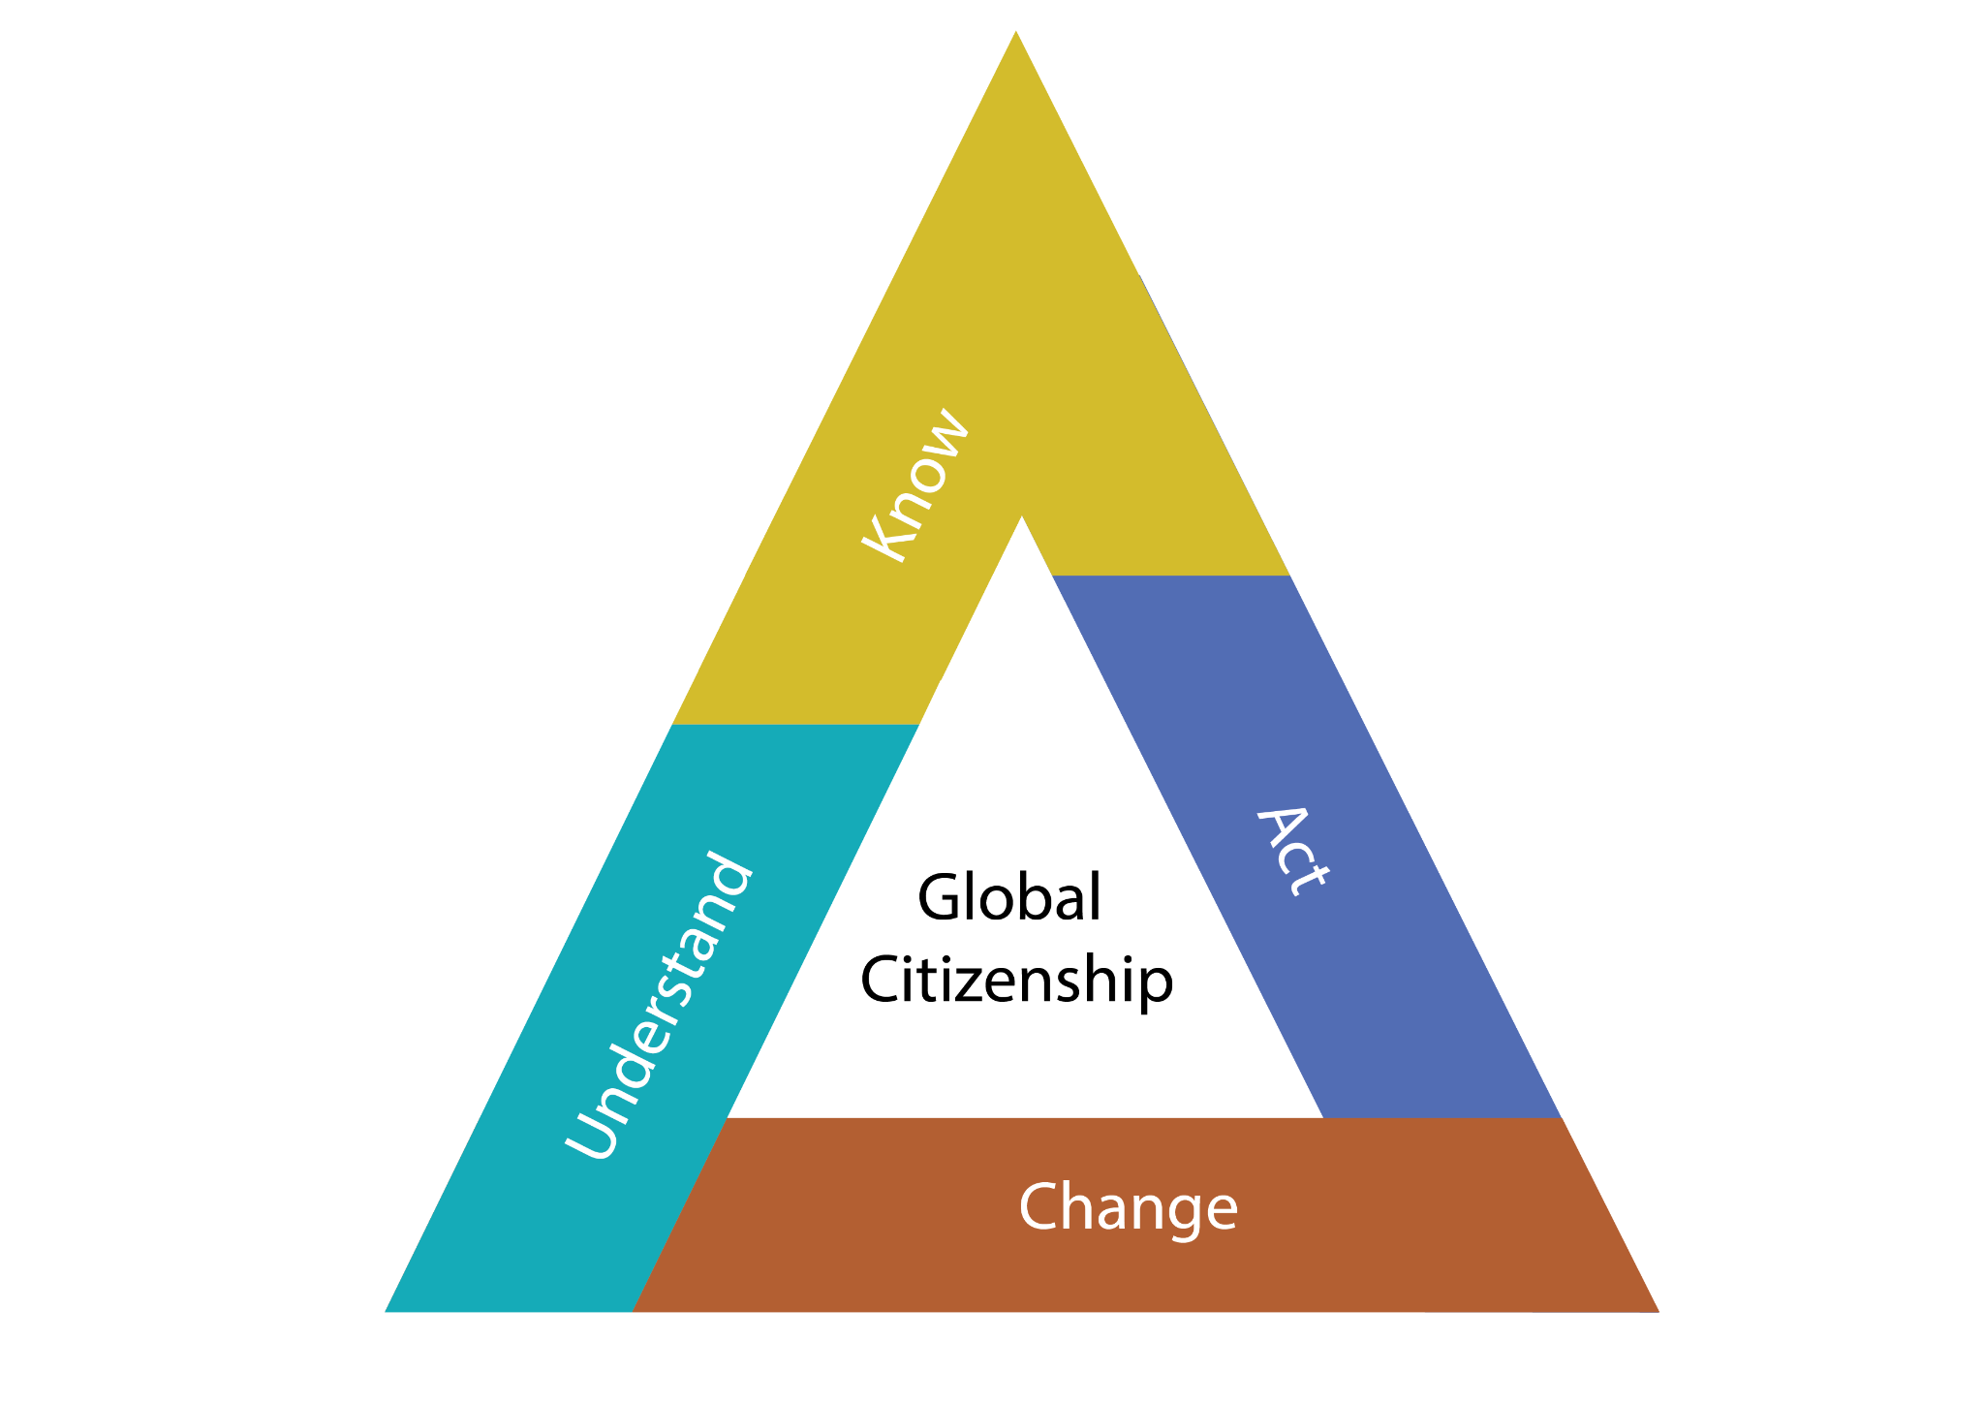
Development Issues/ Topics
GCE attempts to show the relationship of social and environmental issues and work towards solving them
Climate Change- biodiversity loss, drought
Clean energy and renewable energy- food stoves, heating, solar, wind
Food systems- Food sovereignty, legal issues around patents, zero hunger
Human Rights- Equality, Equity, Justice, Peace, Gender-based Violence, Child Labour
Movement of people- Forced migration, displacement, international protection
Systems- Development, Economy, Capitalism, Patriarchy, Root causes, Resource distribution
Global Inequality and naming systems of power, locally, nationally and internationally
Democratic and equitable participation

Slide 7
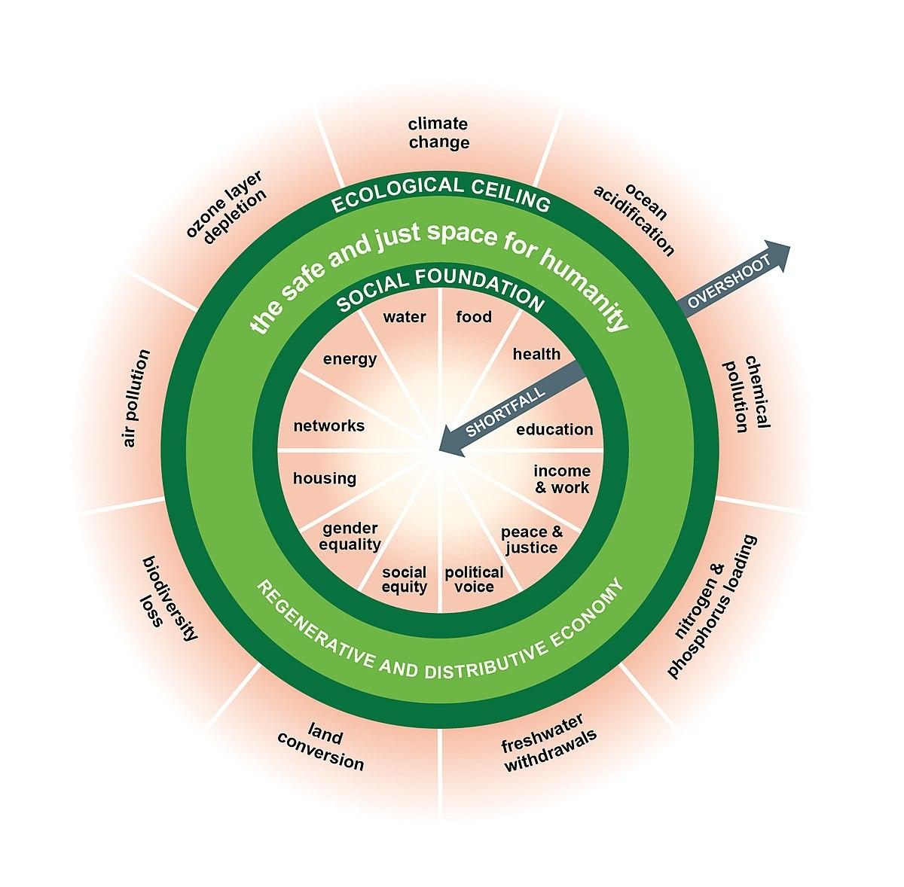
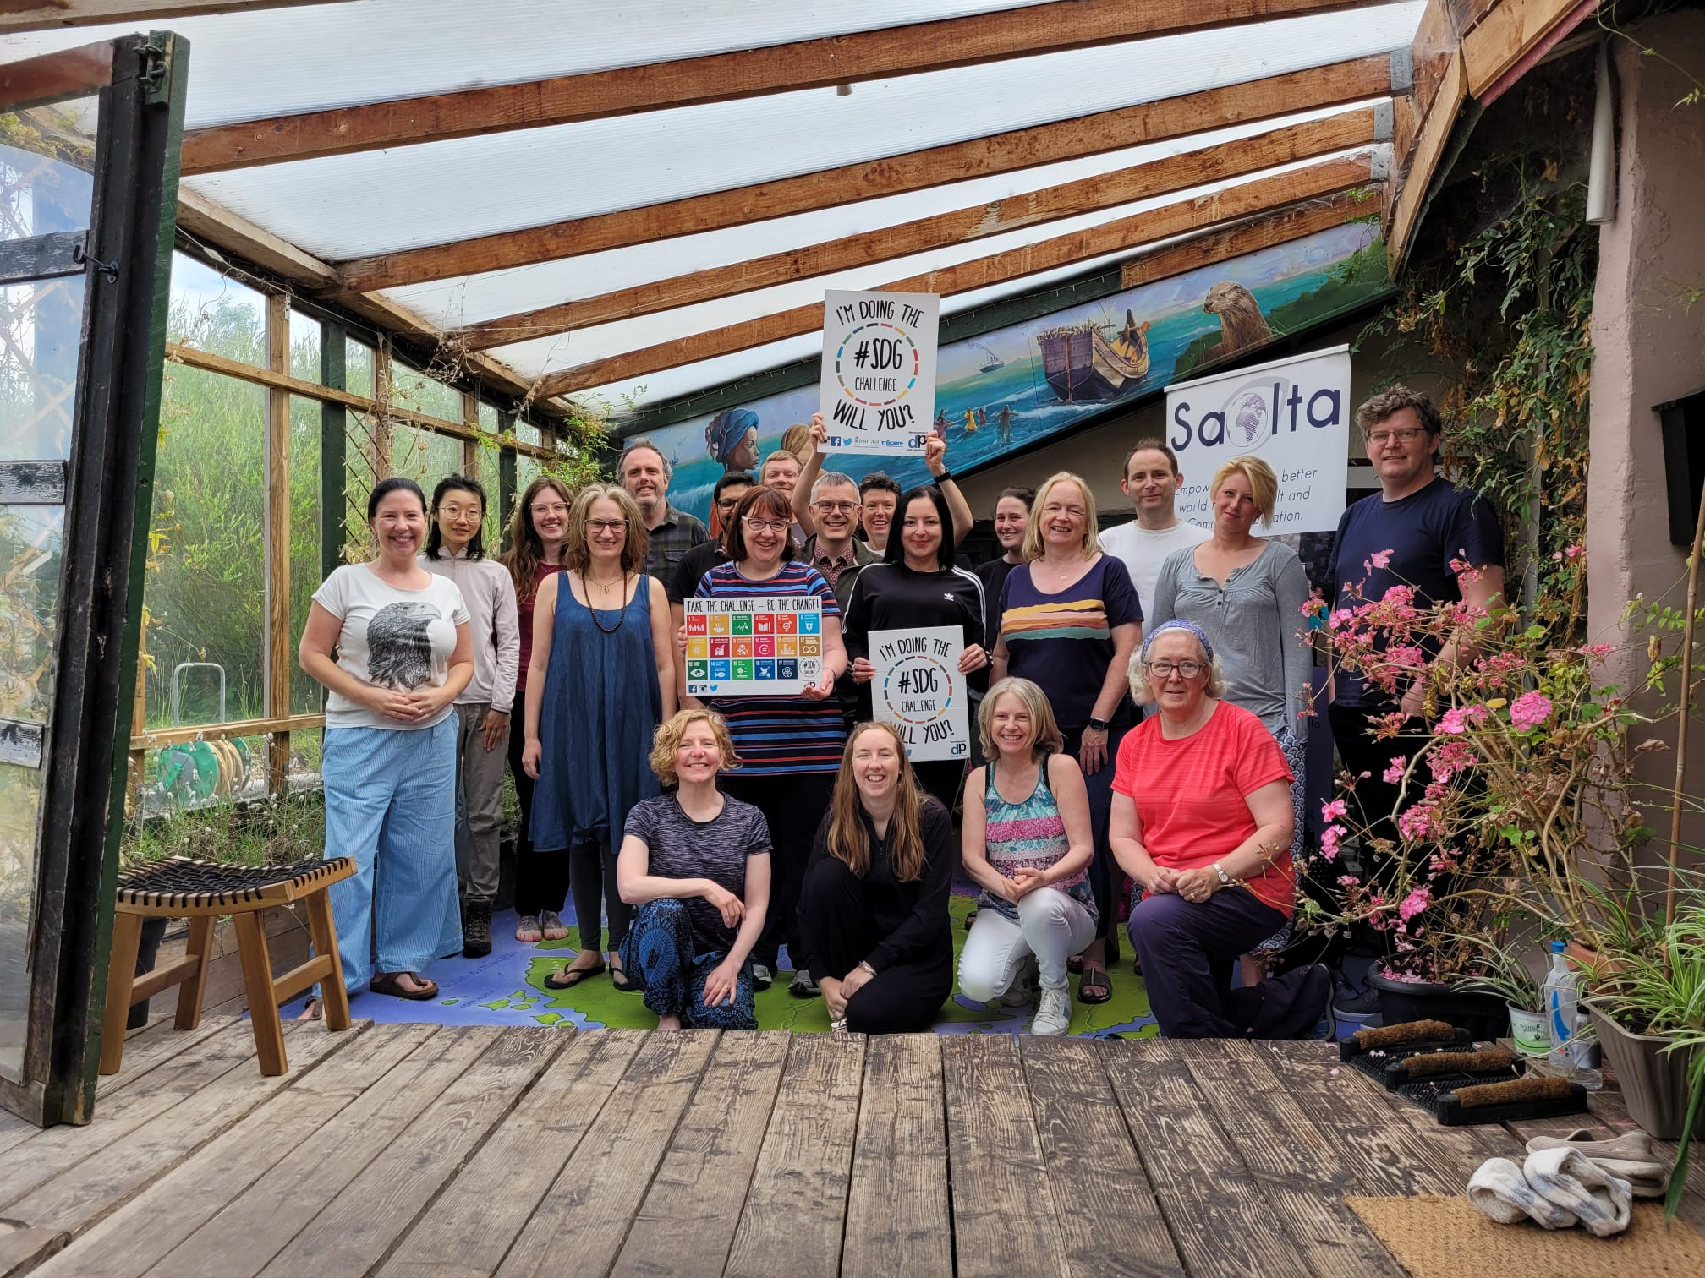
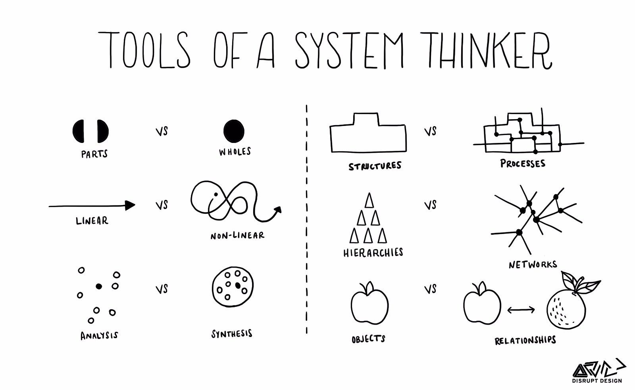
The Four pillars of
Global Citizenship Education
Critical Thinking
Systems Thinking
Problem Solving
Active Citizenship

Slide 8
What is Critical Thinking?
It is the ability to think and evaluate things in an objective way and to be aware that we need to question our own ways of thinking (bias, prejudice) and to consider multiple perspectives.

Slide 9
Problem Solving
Problem-solving skills are the ability to identify problems, brainstorm and analyse answers, and implement the best solutions.
A good problem solver aims to understand the root of a problem and work with others to consider a wide range of solutions before deciding how to move forward.

Slide 10
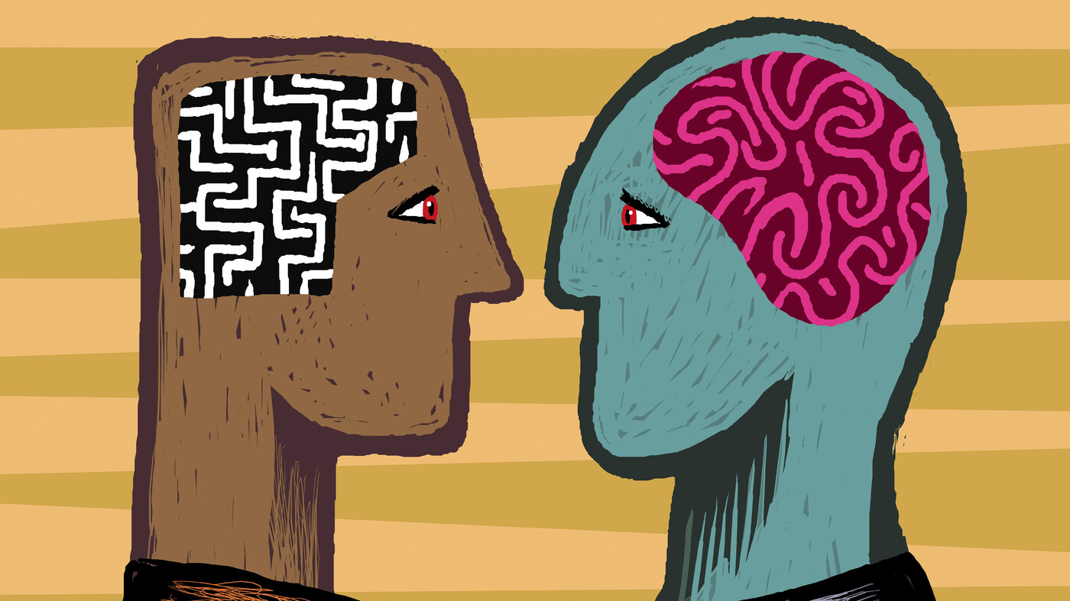
Problem Solving: Design Thinking
Empathise
Define
Ideate
Prototype
Test

Slide 12
Active Citizenship
Active citizenship promotes:
Participation in the community;
Empowering people to influence the decisions which affect their lives;
Knowledge and understanding of the political, social, and economic context of their participation so that they can make informed decision;
Ability to challenge existing structures.
Active citizenship can be referred to as “participation in civil society, community and/ or political life, characterised by mutual respect and non-violence and in accordance with human rights and democracy” (Hoskins, 2012).
Active citizenship is quite simply doing anything to express values or to achieve something for the common good.
Notes:
Watch the videos to understand more about Active Citizenship:
What is Active Citizens: https://www.youtube.com/watch?v=kiZNO_Lca8k
We The People: https://www.youtube.com/watch?v=C3IRW4zH18A

Slide 13
Are you a Global Citizen already?

Slide 14
What does it mean to be a Global Citizen?
A Global Citizen is someone who:
is aware of the wider world and has a sense of their own role as a world citizen
respects and values diversity
has an understanding of how the world works
is outraged by social injustice
participates in the community at a range of levels, from the local to the global
is willing to act to make the world a more equitable and sustainable place
takes responsibility for their actions.

Slide 15
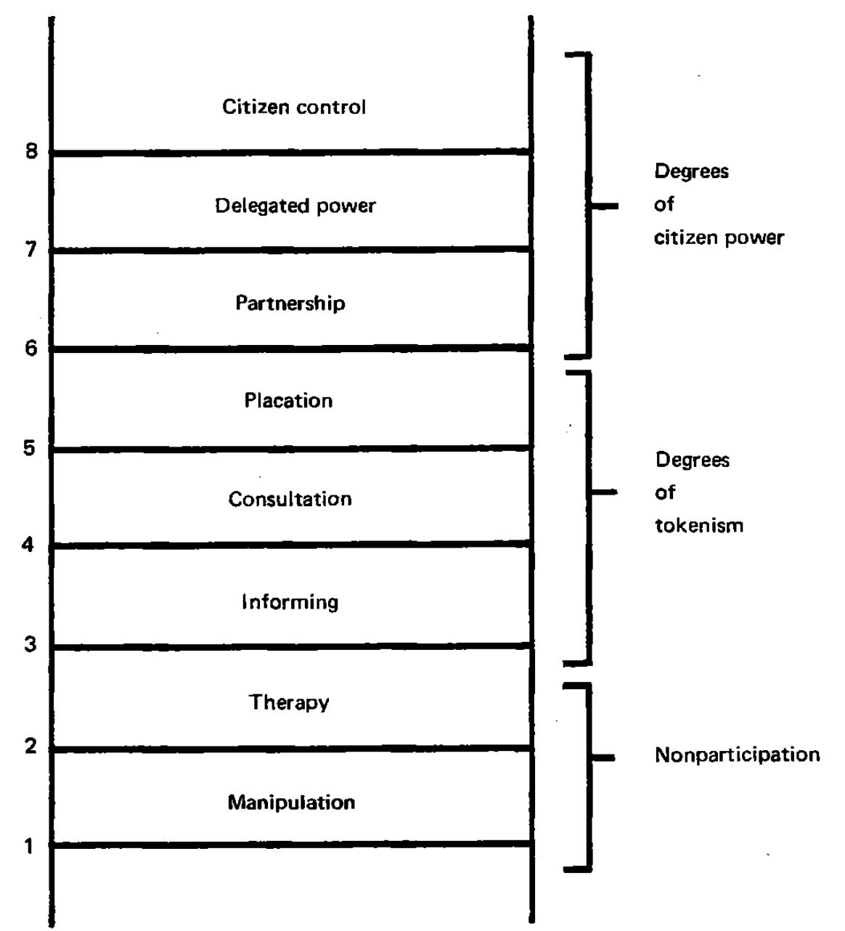
Power + Participation
Who has the right to vote?
EU Citizens
Irish Citizens
Residents
Asylum Seekers
People in the Prison Service

Slide 16
Active Citizenship
Representation
inclusive
diversity of perspectives
democratic
identities
Accountability
enacting legislation
Duty of elected representatives
pledges
delivery of services
Participation
Your vote is your voice
Social impact
Representing community and individual views
Civic rights
Partnerships
Shaping services

Slide 17
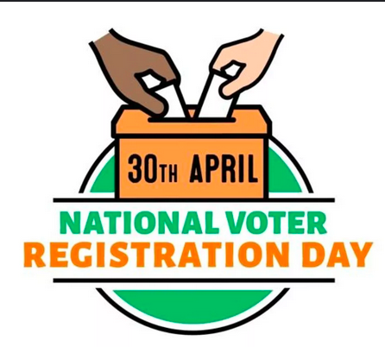
Register to vote
The deadline to register and update your details for the 7th June 2024 Local & European Elections for standard voting is 20 May 2024, and the deadline to register for a postal vote was 11 May 2024.

Slide 18
The Sustainable Development Goals

Slide 19
UNITED NATIONS SUSTAINABLE DEVELOPMENT GOALS
17 Goals
169 Targets
235 Indicators
193 United Nations Countries
8 million entities
Notes:
“The goals are ‘indivisible’, meaning that they are mutually reinforcing. Hence a sensitivity to the interactions between the goals is fundamental to their achievement.”- Coalition 2030 Doc

Slide 20
What are the Sustainable Development Goals?
At the heart of the 2030 Agenda for Sustainable Development that was adopted by all United Nations Member States in 2015.
There are 17 Goals in total
They are also known as the Global Goals
They address the global challenges we face, including those related to poverty, inequality, climate, environmental degradation, prosperity, and peace and justice.
The 17 SDGs are integrated – they recognize that action in one area will affect outcomes in others, and that development must balance social, economic and environmental sustainability.

Slide 21
The SDG Web of Connection
Notes:
Choose the SDG you think is the most important
Why did you choose this one?

Slide 22
Sustainable Development Goals CATEGORIES

Slide 23
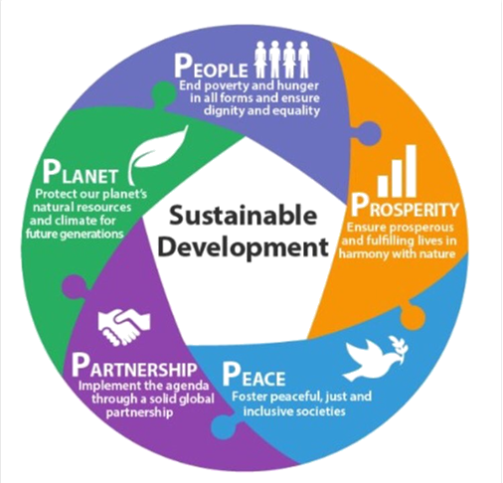
THE 5 PS
Planet
People
Peace
Prosperity
Partnership

Slide 25
Who are they for?
One of the most important aspects of the SDGs is that they are for everyone.
They are applicable locally and globally.
Every individual, organisation, country, and international institution is responsible for helping to achieve them.

Slide 26
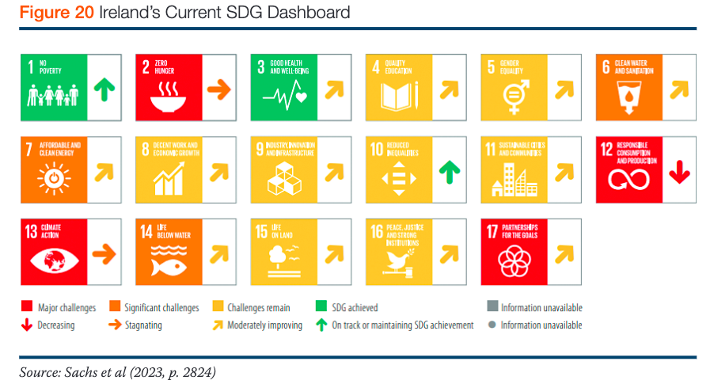

Slide 27
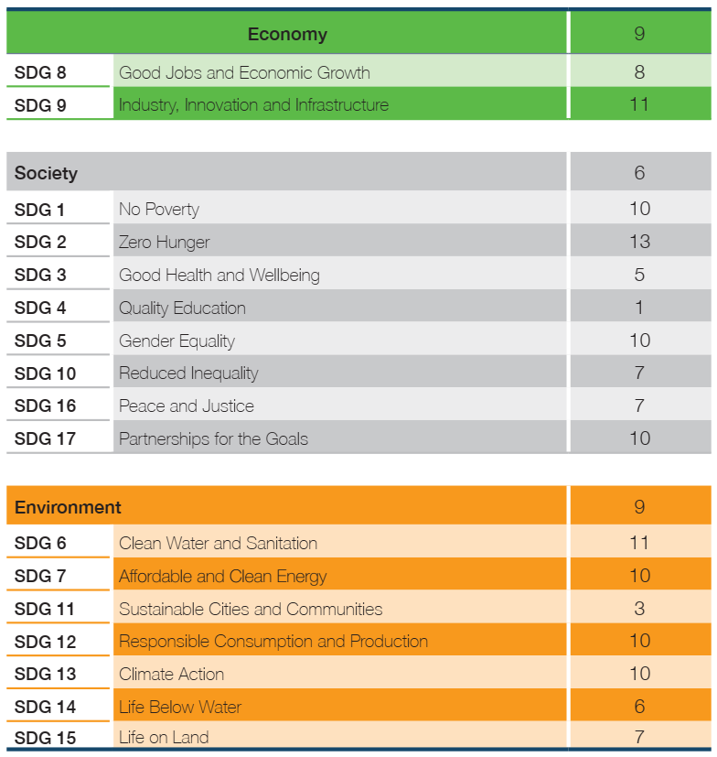
Ireland’s ranking in EU
Source: Social Justice Ireland, Sustainable Progress Index 2023

Slide 28
Public Awareness- DOCHAS
https://www.dochas.ie/resources/worldview/research-approach/
Ms McKenna concluded: “More needs to be done to highlight how our own actions can impact climate and the devastating effects this can have on developing countries.”
Just 12% of Irish people have heard about and know what the Sustainable Development Goals (SDGs) are. 56% have not heard of them
There is an inverse relationship between importance and achievability: People in Ireland believe SDG1 (No Poverty) is the most important goal, while also believing it is the least likely to be achieved by 2030
When asked about the consequences of climate change for developing countries 53% of Irish people said food and water shortages will be the biggest impact
Irish people believe climate change will have the greatest impact on future generations (59%) and people in developing countries (51%) as against 14% for them personally
43% of respondents think that (other) people in Ireland should do more to address climate change in developing countries versus the Irish Government (40%) and themselves personally (17%)

Slide 32
Another Angle: SDGs in Viet Nam

Slide 33
A Brief Look at Viet Nam
Official name: The Socialist Republic of Vietnam
Geographical location: Located in Southeast Asia
Climate: Tropical monsoon
Population: around 99,101,412 people (Nov 16, 2023)
Economic-related numbers: Lower middle income economy
Gross Domestic Product (GDP): 408.80 billion US dollars (World Bank, 2022)
EUR/VND (Vietnam Dong): 1 EUR = 25,890.191183 VND (August 18, 2023)
History:
One of the earliest agricultural centers practicing wet rice farming;
The Van Lang State, the first State in Viet Nam was established in the 7th century B.C;
Gained independence on April 30th, 1975;
“Doi Moi” (Reform) policy was approved in 1986.
Political system: single party under an authoritarian system, the Communist Party of Vietnam (CPV).
Members of many international communities/ associations (ASEAN, WTO, UN, APEC, ASEM, etc.) and international Free Trade Agreements (FTAs).

Slide 34
SDGs Implementation Scheme in Viet Nam
Human Resources & Approach
Finance & Budget
Legal & Policy Frameworks

Slide 35
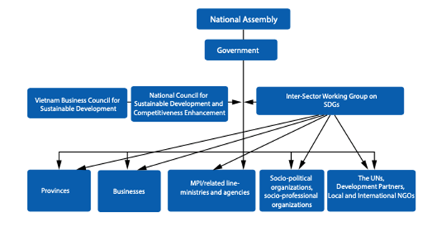
Human Resources & Approach
Top-down approach (mainly)
The Ministry of Planning and Investment (MPI) is the lead agency for implementing the 2030 Agenda and the National Action Plan (NAP)
Source: Viet Nam’s Voluntary National Review on SDGs Implementation, 2018

Slide 36
Finance & Budget
Financing for SDGs implementation process through:
State budget;
Private sector;
Foreign sources, including both Official Development Assistance (ODA) and Foreign Direct Investment (FDI).

Slide 37
Legal & Policy Frameworks
Localise SDGs into Viet Nam Sustainable Development Goals (VSDGs)-17 goals, 115 targets;
Many legal and policy papers related to SDGs implementation have been issued:
National Action Plan (NAP) for the Implementation of the 2030 Sustainable Development Agenda;
"One Strategic Plan” (OSP) aimed at integrating the SDGs with Vietnam’s Socio-Economic Development Strategy (2011-2020) and Socio-Economic Development Plan (2016-2020);
Viet Nam’s Voluntary National Review on the SDGs Implementation (VNR) 2018;
Viet Nam’s VNR 2023;
Vietnam’s Socio-Economic Development Strategy (2011-2020) and Socio-Economic Development Plan (2016-2020);
Vietnam’s Socio-Economic Development Strategy (2021-2030) and Socio-Economic Development Plan (2021-2025);
Etc.

Slide 38
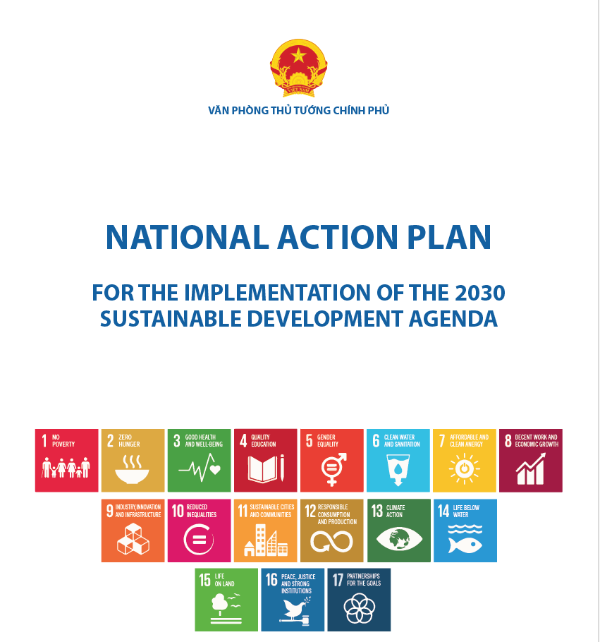
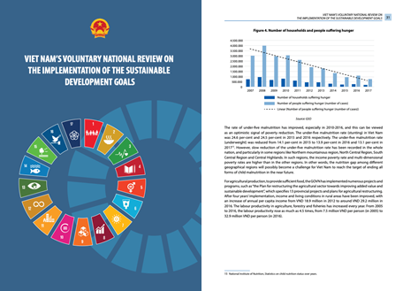
Legal & Policy Frameworks
Source: United Nations Statistics Division Statistical Services Branch, 2023

Slide 39
Case Study 2030 Youth Force Vietnam Network

Slide 40
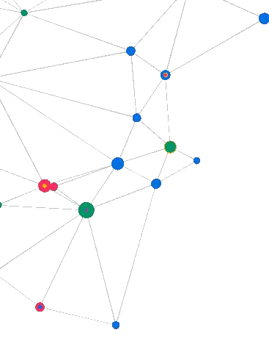
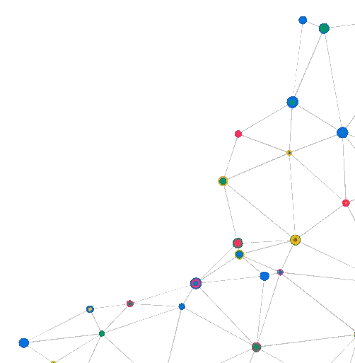
GENERAL INTRODUCTION
2030 YOUTH FORCE VIETNAM

Slide 41
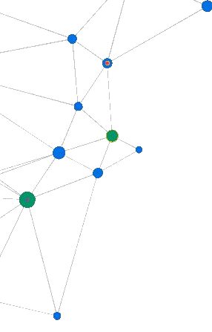
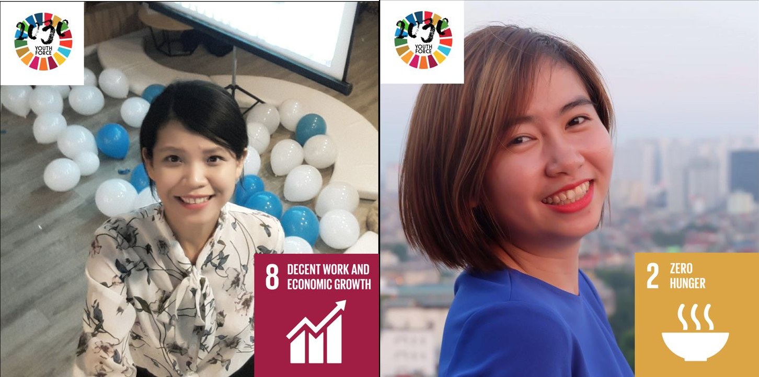
ABOUT 2030 YOUTH FORCE VIETNAM
01
The 2030 Youth Force was established by 19 young leaders from Asia-Paciﬁc who were selected and assisted by UNDP/UNV at the Asia-Paciﬁc Youth Platform in 2016.
The 2030 Youth Force presents in 8 nations: Philippines, Indonesia, India, Cambodia, China, Mongolia and Vietnam in 2022.
Vietnamese co-founders: Ms. Nguyen Nhu Quynh & Ms. Phan Thuy Dung.

Slide 42
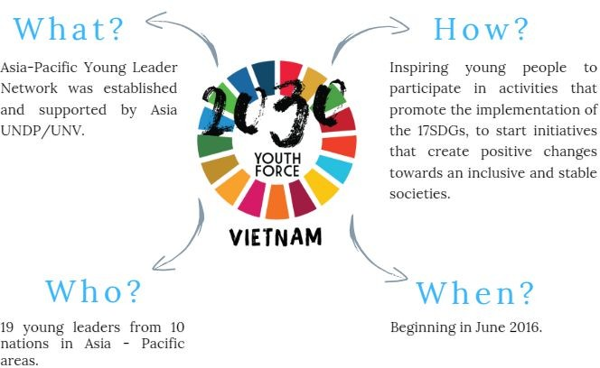
2030 YOUTH FORCE ASIA-PACIFIC

Slide 43
2030 YOUTH FORCE VIETNAM
The ﬁrst and largest non-proﬁt Network of Youth Organization in Vietnam concentrates on promoting the quality of community development initiatives and having positive social inﬂuences on youths to contribute to accomplish the Sustainable Development Goals’ achievements.
OUR MISSION
Contribute synergistically to the realization of sustainable development;
Support young people’s advanced capabilities for community growth.
Spread the social activity spirit.

Slide 44
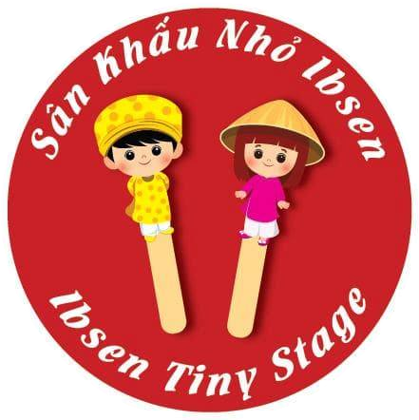
OUR GROUP MEMBERS

Slide 45
MAIN ACTIVITIES
02
CONNECTION
National Planning Meeting, Regional Meeting, Impact Accelerator Ecosystem
TRAINING
Youth Leaders Incubator Programme (Youth Leaders Camp/ Talk/ Share)
SPREAD THE SDGs
Other online and ofﬂine projects and programmes.
The number of projects (July/2016 – June/2023): 40
*Just counted the National and Regional Levels

Slide 46
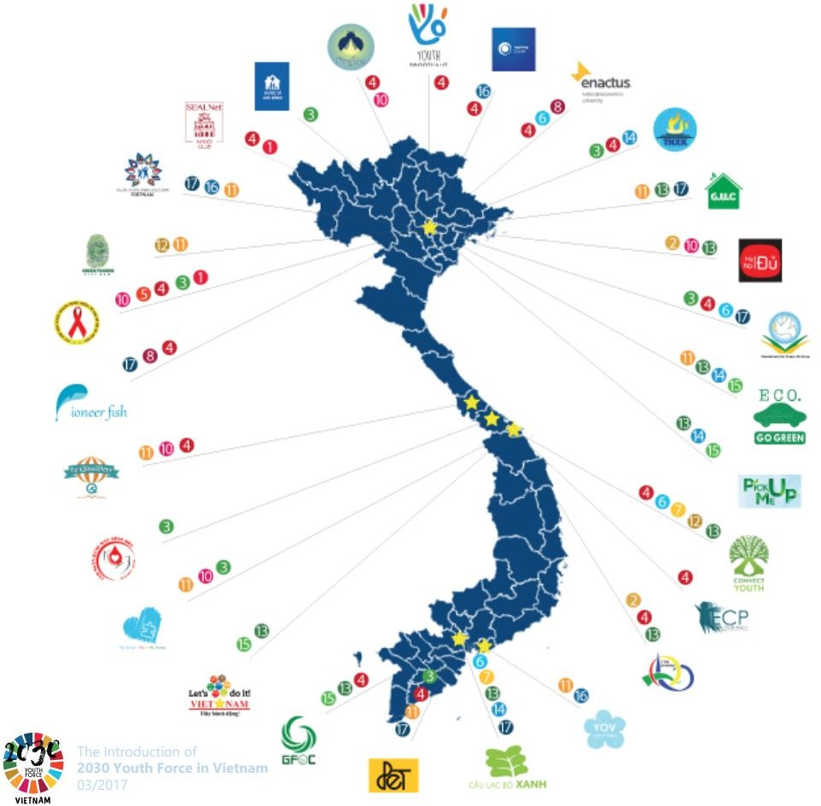
ACHIEVEMENTS (2016 - 2022)
34,000+ likes Facebook fanpage
10,000,000+ reaches Facebook fanpage
200 Volunteering Coordinators
70 CSOs Member groups
29 Partnerships
40 Projects (organized by Coordinators)
16,000+ youths take part in activities.

Slide 47
Facebook: facebook.com/youthforce.vietnam Email: 2030youthforce.vietnam@gmail.com

Slide 48
Learning Lessons

Slide 49
The power of collective effort

Slide 50
Effort in truly leaving no one behind

Slide 51
“Never doubt that a small group of thoughtful, committed citizens can change the world; indeed, it’s the only thing that ever has.” – Margaret Mead.
If you want to go fast, go alone.
If you want to go far, go together.
- African proverb.

Slide 52
SHORT BREAK
LET’S COME BACK IN 5’!

Slide 53
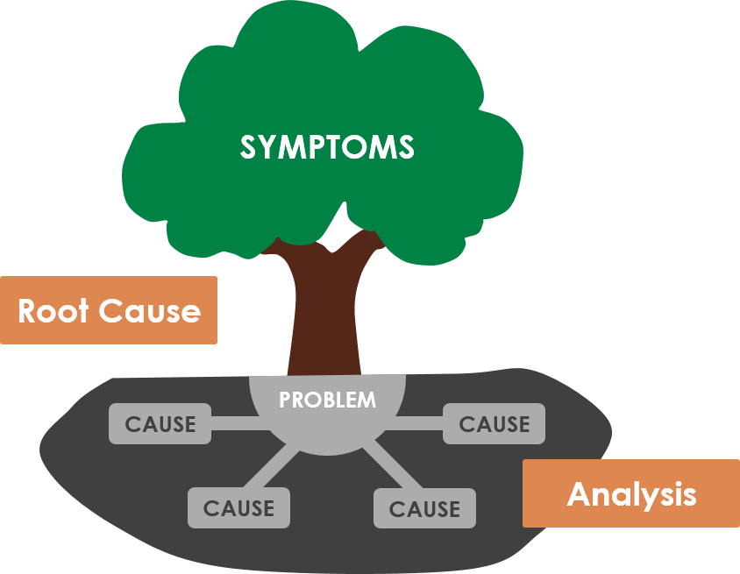
Problem/Solution Tree

Slide 54
Moving into action
What is an issue of interest to your community or group?
-Which SDGs can be linked to these issues?
What does sustainable community development look like? (Draw, describe, what can you see?)
Who is at risk of being left behind? What is needed to support the furthest behind first?

Slide 55
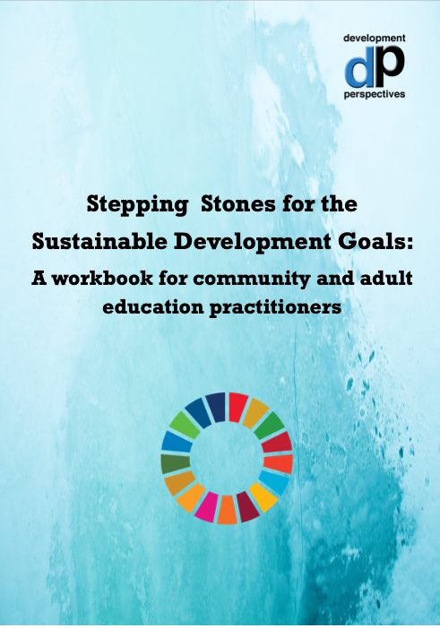
Using the SDGs for Action

Slide 56
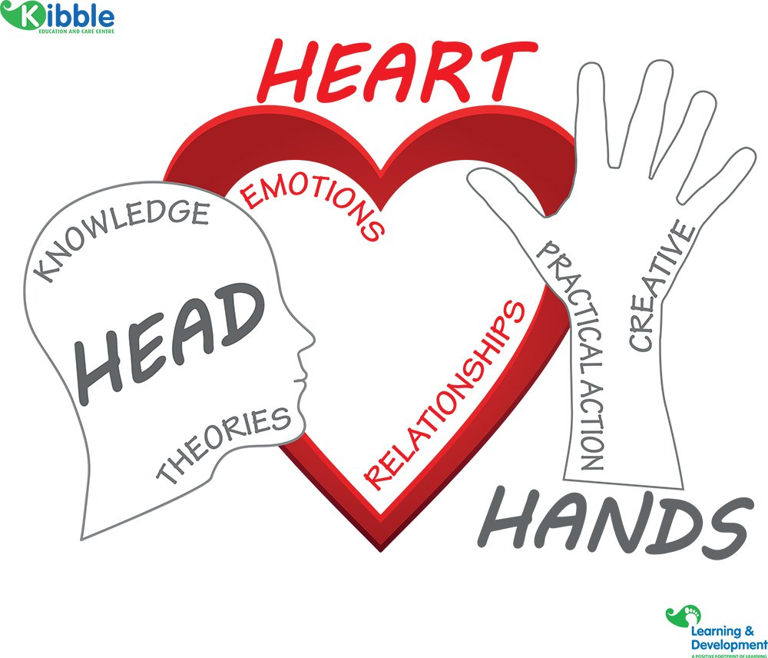
Using the SDG’s for action
Mind
Body
Heart
Problem Solving
Critical Thinking
Systems Thinking
Active citizenship
Environmental
Social Inclusion
Community and Voluntary

Slide 57
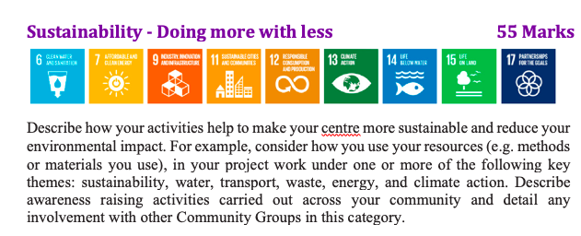
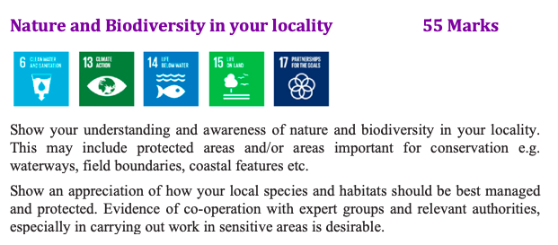
Local adoptions of the SDGs

Slide 58
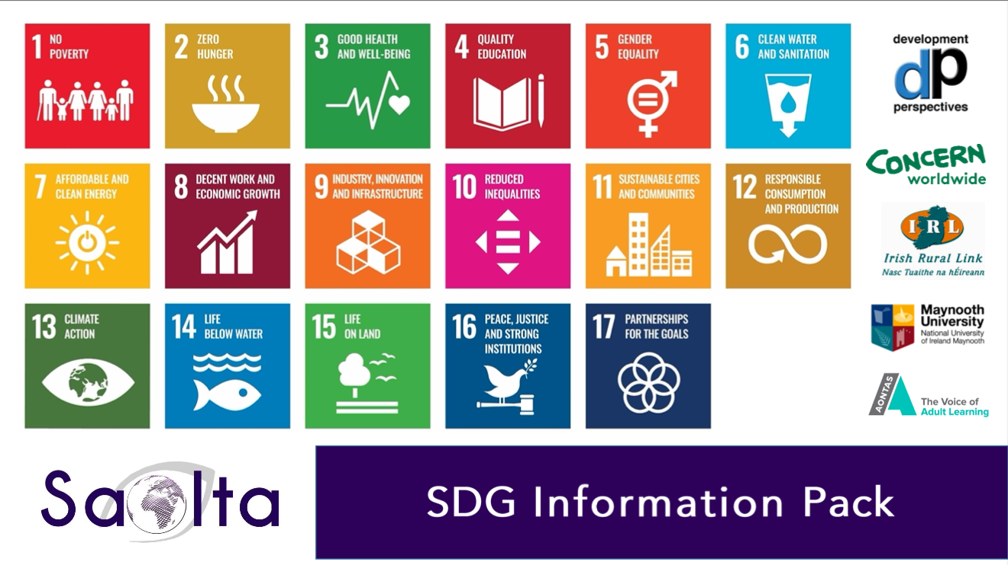
SDG Challenge and Infopack
Saolta.com
->
Resources

Slide 59
What’s next?- Resources, topics mentioned tonight
Resources from Saolta and Development Perspectives (Workbook and Monthly SDG Info Pack)
www.saolta.com , https://developmentperspectives.ie/
Video from Fenit (Kerry) about their Welcome sign
https://www.facebook.com/watch/?v=1286954431766403&ref=sharing
Irish Gov Implementation Plan 2022, bottom of page has updated ‘2022 Policy Map’ and ‘Policy update on Ireland’s implementation of SDG targets’
https://www.gov.ie/pdf/?file=https://assets.gov.ie/26895/0cae9372eeeb406cbe3452d00b90ad6b.pdf#page=null
Social Justice Ireland and Financial Justice Ireland’s websites are great resources too!
The Danish Institute for Human Rights- ‘HUMAN RIGHTS AND THE 2030 AGENDA FOR SUSTAINABLE DEVELOPMENT (2018)’
https://www.humanrights.dk/sites/humanrights.dk/files/media/dokumenter/sdg/hr_and_2030_agenda-web_2018.pdf

Slide 60
Kate Raworth and Doughnut Economics: https://www.ted.com/talks/kate_raworth_how_to_live_within_the_doughnut?language=en
Arnstein’s ladder of citizenship participation: https://www.citizenshandbook.org/arnsteinsladder.html
Schwartz Circumplex of Basic Human Values:
https://medium.com/@alvise.nudge/practical-applications-of-schwartzs-theory-of-basic-human-values-332da0879d19
Ireland’s 2023 National Voluntary Review – Sustainable Development Goals: https://www.gov.ie/pdf/?file=https://assets.gov.ie/261436/e304fd76-2efa-4bad-93ba-595c29a8d2fe.pdf#page=null

Slide 62
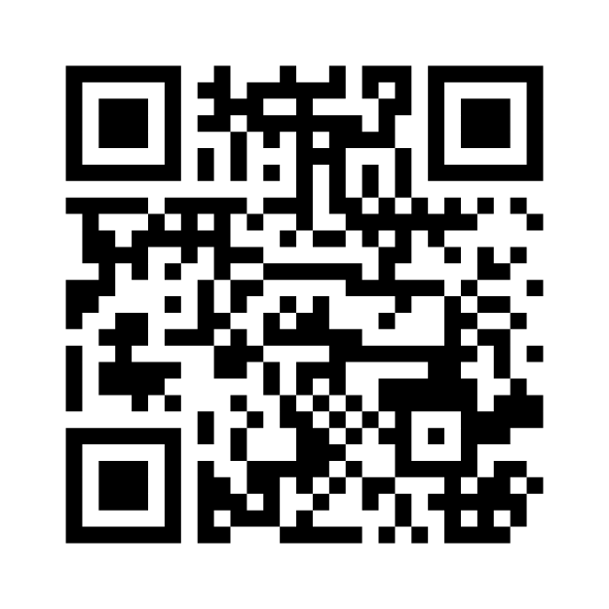
Evaluation!
Please share with us your feedback about this session by either:
Joining at menti.com, then enter code: 6554 3912
https://www.menti.com/alimmgardgp3
Scan the QR code
Thank you for your participation!
Best of luck embedding the SGDs and finding the link and connections to your work, and in collaboration with other groups across Dublin!
Please keep in touch with us via:
quynh@saolta.com
nick@saolta.com

