Slide 1
How to Effectively Manage Social Media
DCU Digital Communications
Jane Last
Head of Digital Communications, DCU
Ger Shiels
Social Media & Online Engagement Editor,
DCU

Slide 2
Overview
Intro to Digital Comms
Intro to Social Media Policy
Overview of DCU’s main social media platforms
Defamation/Complaints
X/LinkedIn/Meta/TikTok
Questions

Slide 3
Social Media – DCU Digital Comms
DCU Communications, Marketing and Events (CME) Department
PR & Communications
Marketing
Central Events
Digital Communications

Slide 4
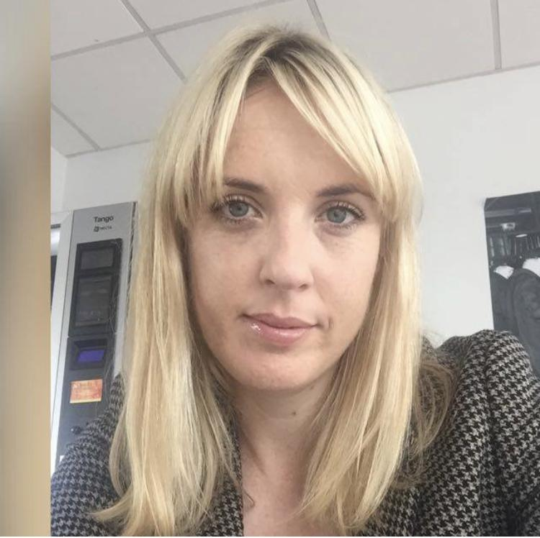
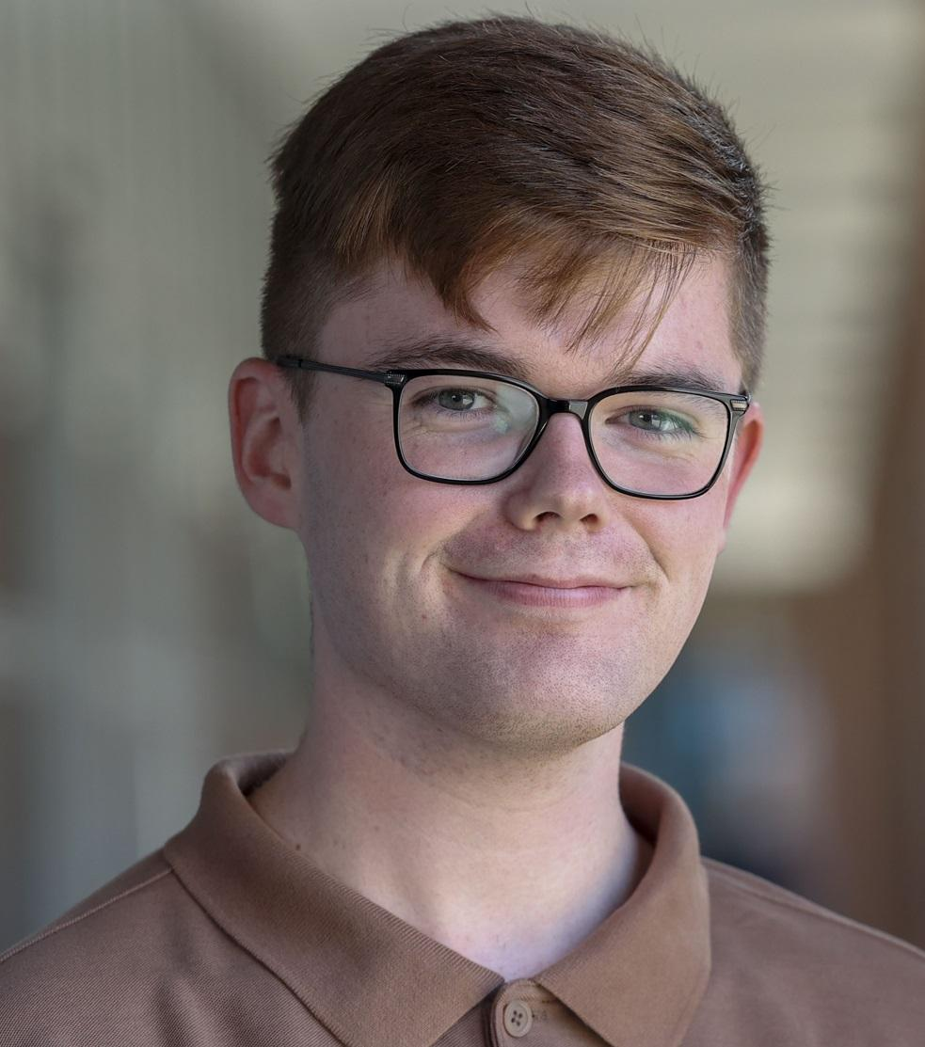
Social Media – Digital Comms
Jane Last
Head of Digital Communications, DCU
Digital Communications
Social Media Channels
Social Media support
DCU.ie with ISS
Provide analytics
Provide support for ‘live’/virtual events
Ger Shiels
Social Media & Online Engagement Editor,
DCU

Slide 5
DCU’s Social Media Channels
LinkedIn – 132,000 followers
Facebook – 68,000 followers
X (formerly Twitter) – 45,900 followers
Instagram – 35,900 followers
TikTok – 7,100 followers/180.8k likes

Slide 6
Social Media – DCU
Engage
Inform
Build
DCU Social Media Channels allow us to engage with our communities, stakeholders and students
Notes:
Please emphasise – we do not see our social media channels as marketing feeds. Also audiences have grown since July – people are interested in DCU content

Slide 7
Social Media – DCU Platforms
Different voices for different platforms
Facebook – Our most engaged audience on Facebook is women aged between 35 and 55
3,000 DCU employees on LinkedIn, 83,000 alumni
45k followers on X (Twitter) – DCU Newsfeed
Instagram – Almost 50% of audience is aged between 18-24. 60% women, 40% men and most active between 3pm and 9pm
TikTok – 70pc female – most active between 10pm and 11pm. 377k video views from September to November 2023
Notes:
Different voice for different platforms

Slide 8
DCU’s Combined Audiences
We now have combined audiences of 277k
Conversations about DCU increased from 30,000 to 100,000 between 2019 and 2022

Slide 9
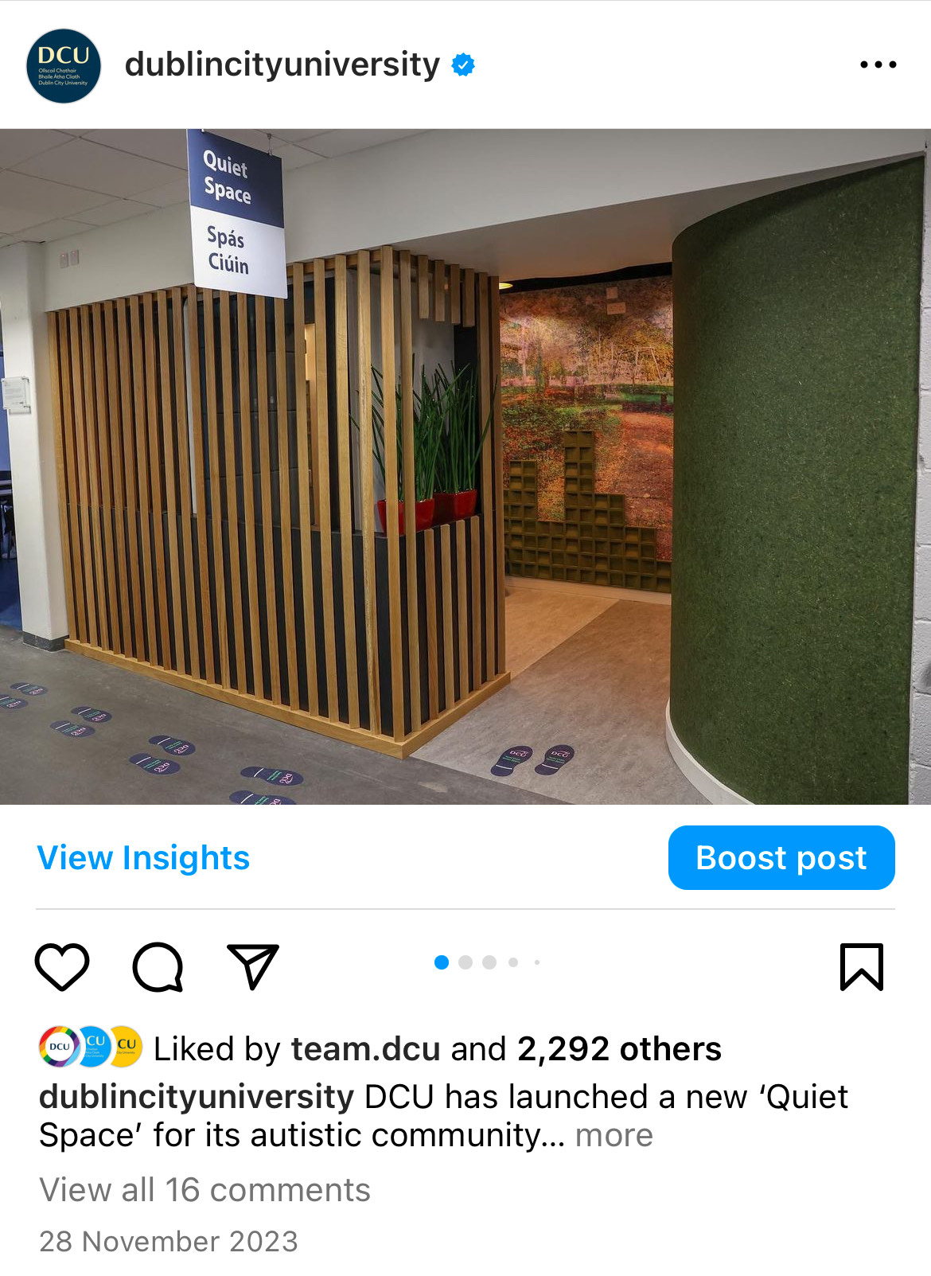
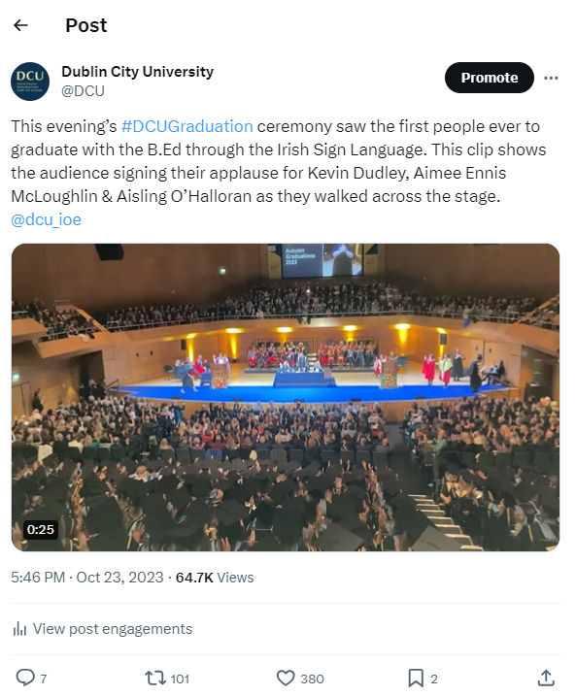
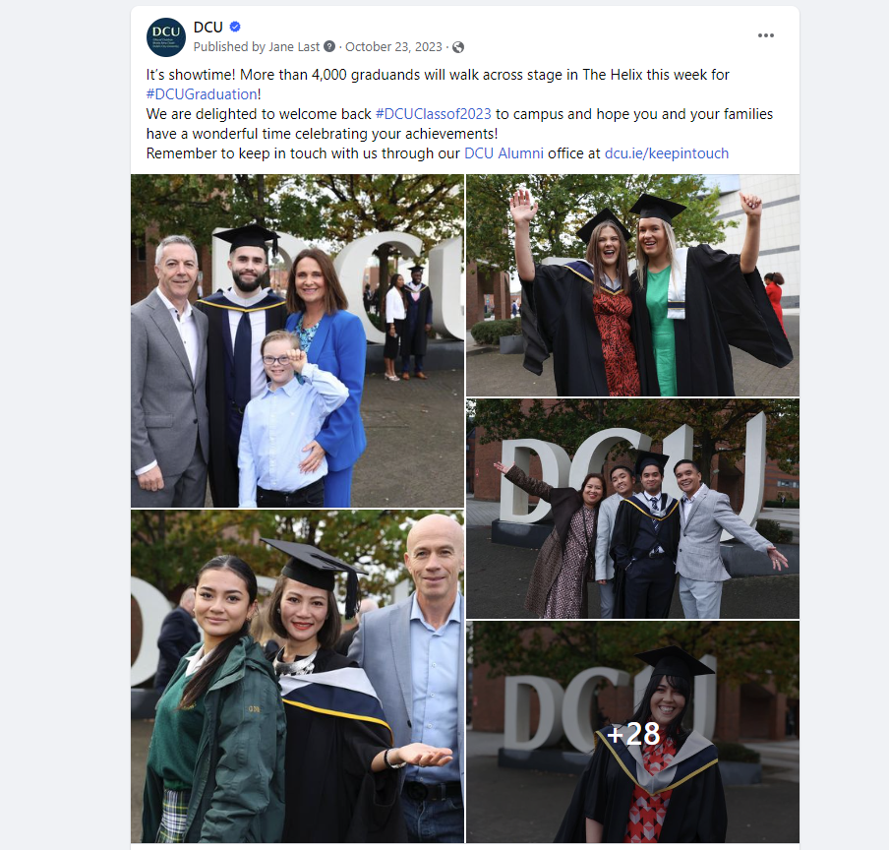
Social Media – DCU’s Top Posts 2023

Slide 10
Social Media Growth – 2022 to 2024
X: 40.5k - 45.9k
Instagram: 23.6k - 35.9k
Facebook: 63.8k - 68k
LinkedIn: 105.7k - 132k
TikTok: 4k - 7.1k / 83k - 180.8k
Notes:
TikTok: Importance of likes over followers

Slide 11
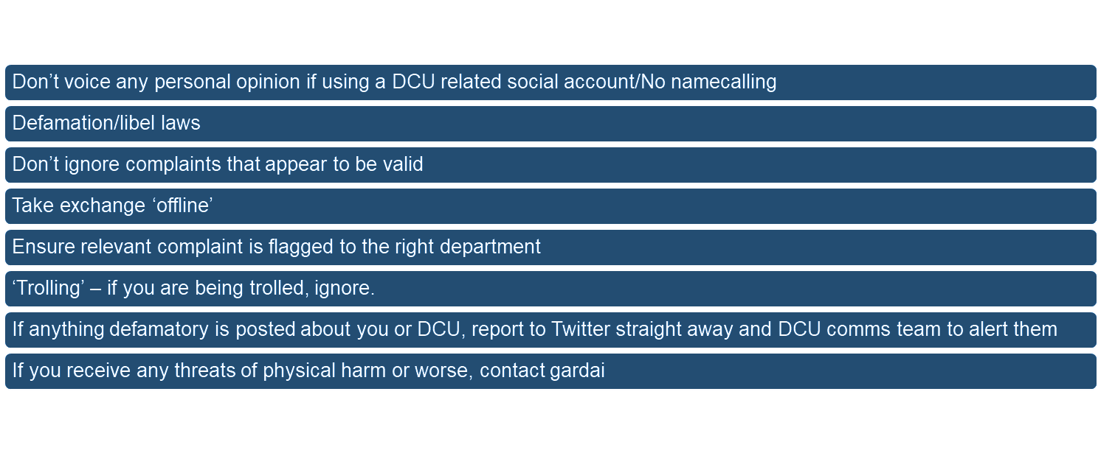
Social Media – Guidelines

Slide 12
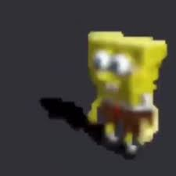
Social Media – Images
Ensure you have permission to use image
Poor quality image = bad impression
People under 18 – use caution
DCU resources: pixiset, branding@dcu.ie, in-house photographer, phone

Slide 13
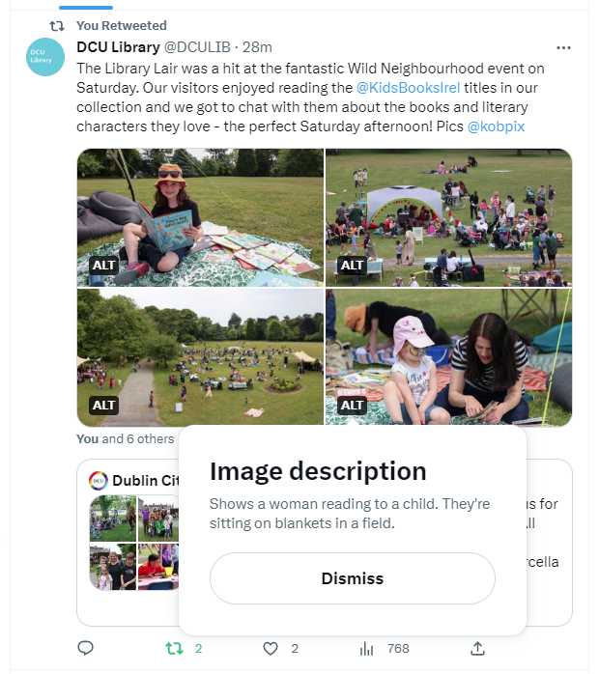
Social Media – Accessibility
Growing awareness of accessibility on social media
Does not come in under legislation
Captions on video
Use of ‘alt tag’ on social platforms

Slide 14
Social Media – Engagement
Don’t just engage with the positive
Look to deal with complaints ‘offline’
Always respond kindly
Feedback = engagement
Call to action
Listen to what your audience is saying
Notes:
Building a social media following takes time – do you want to commit?

Slide 15
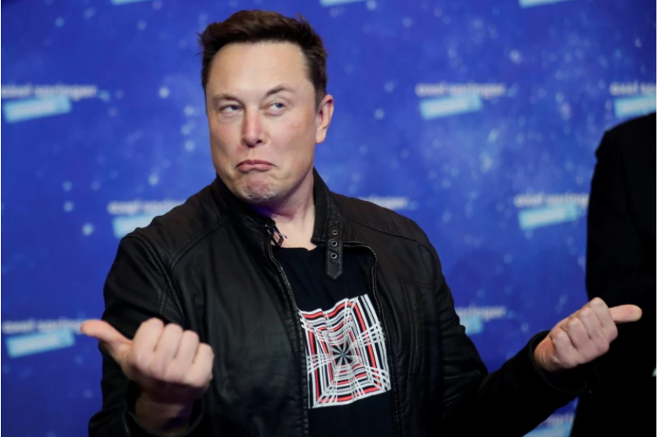
X (formerly known as Twitter)
Notes:
CBS News
Fake Accounts
New ‘official’ tag
Impact on traffic

Slide 16
Suggestions for X/Twitter
Twitter is a bubble… not everyone is on it/When does the professional end and personal begin…
Great for distributing content from other platforms
30pc info/news, 30pc ‘core message’, 30pc fun
Always use a visual, tweet often, engage
Tag peers, colleagues, schools, faculties, societies
Issues include: fake accounts, echo chamber, trolls
Notes:
Twitter has about 1.5m users in Ireland… but it likely feels like more due to its popularity in academic and media circles
Important to remember it is a bubble - and it can be very problematic
Among its main advantages is that it’s great for sharing content from other platforms. But I spoke about Independent.ie earlier and how little it drove traffic back to the site.
Other advantages include it is easy to schedule posts on a platform like Buffer or Hootsuite, and therefore have a ‘presence’ across the day or week
This also makes it easier to have a ‘strategy’ – see slide
Best practices on Twitter would include keeping it short, always including a visual and limiting yourself to a maximum of two hashtags
When starting out, tagging as many people as you can can help to build up an audience through retweets and so on

Slide 17
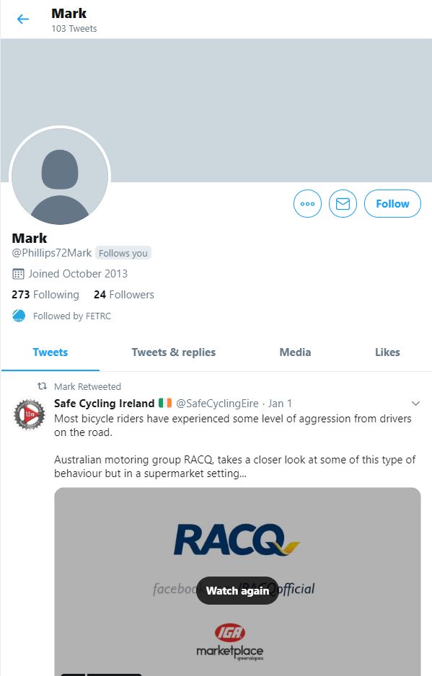
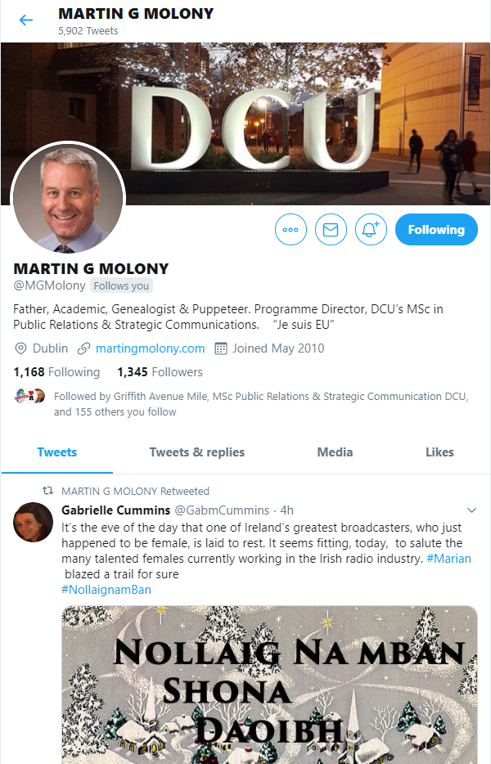
Social Media – X/Twitter

Slide 18
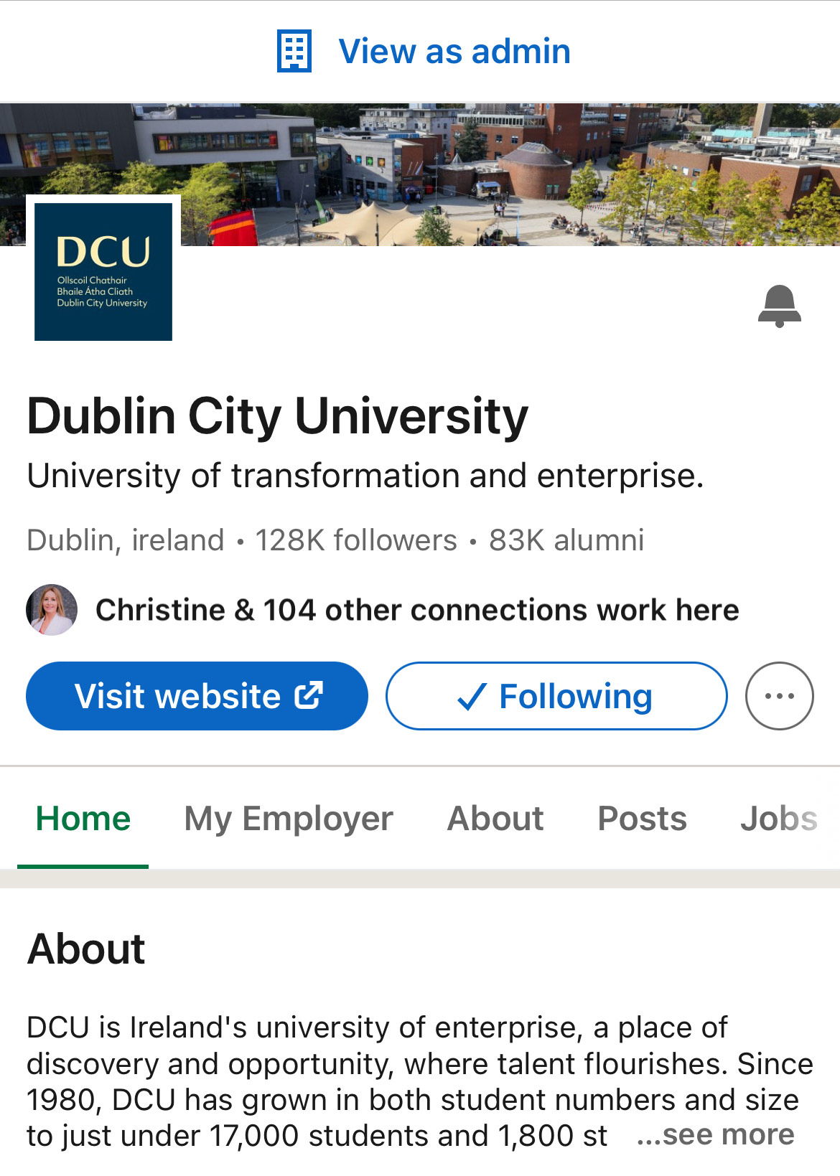
Suggestions for LinkedIn
Professional, serious, aspirational
Thought leadership
Build trust and credibility
Post information/news
Post regularly
Less engagement from wider audience
Less about fun, can be more difficult
Notes:
LinkedIn puts great stock in being the ‘professional’ social media network – and much of the content is serious or aspirational or basically bragging.
I’m not a huge fan but while its potential benefits for people in terms of changing jobs and networking are well known, it also has a role for organisations.
Thought leadership is one area that could work well for DCU affiliated organisations.
What I mean by that is content that maybe gives your expert perspective on news and trends
Or as LinkedIn would put it, ‘Everyone has the capacity to transform lives by communicating a powerful idea’ So that’s ‘good content’ but day to day, you’re looking on LinkedIn more at posting useful information and news, and using that to build the trust and credibility of your brand or organisation
There are plenty of limitations to LinkedIn – it’s quite po-faced, quite narcissistic even for a social media site, and can be boring.
People less likely to engage with your posts, it’s less about fun and therefore it can be difficult to strike a balance between a ‘corporate’ tone and keeping things interesting
You need to think about whether your organisation requires a presence on LinkedIn and whether it will be useful
that performs well for DCU on LinkedIn for example –

Slide 19
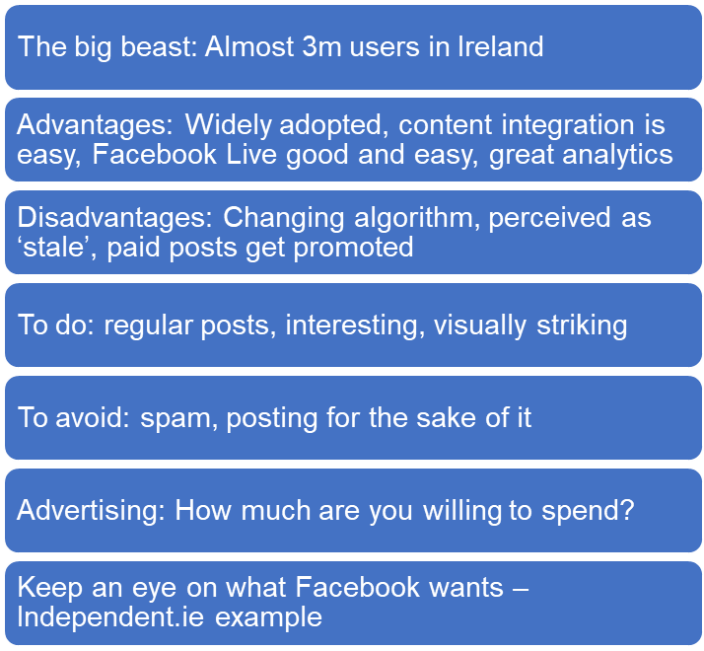
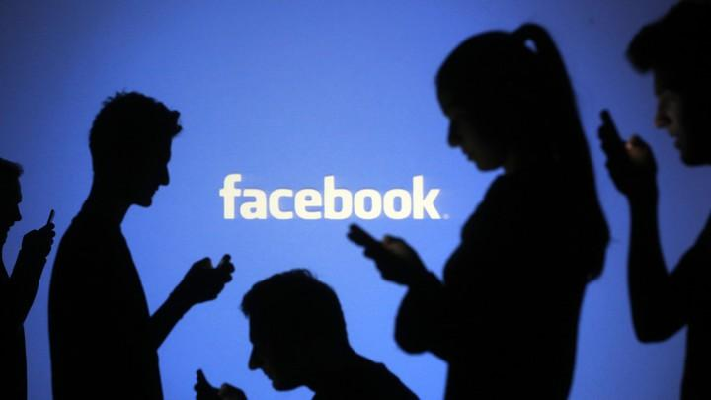
Suggestions for Facebook

Slide 20
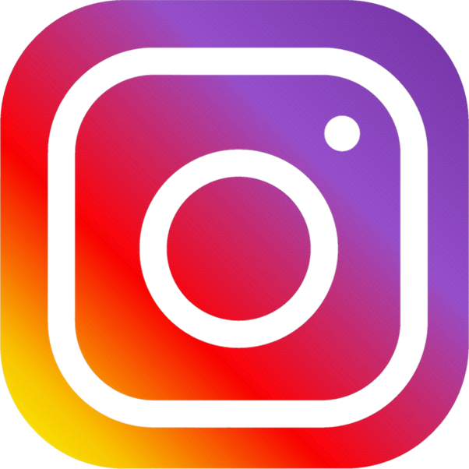
Suggestions for Instagram
2 billion monthly active users – more than X (Twitter)!
Content: Images/Video > Graphics
Wider audience: DCU 49% aged 18 – 24 years old (undergrads)
Casual tone – have fun!
Use hashtags and tag other accounts - increases engagement
Add your location - DCU - Example

Slide 21
Suggestions for Instagram
Share user generated content
What content has the most impressions/reach?
Post regularly - on the grid and on stories
Make use of Instagram stories – shows you're active
Engage with audience - reply to comments/messages - make use of stories to be engaging
Use Reels - Similar to TikTok

Slide 22
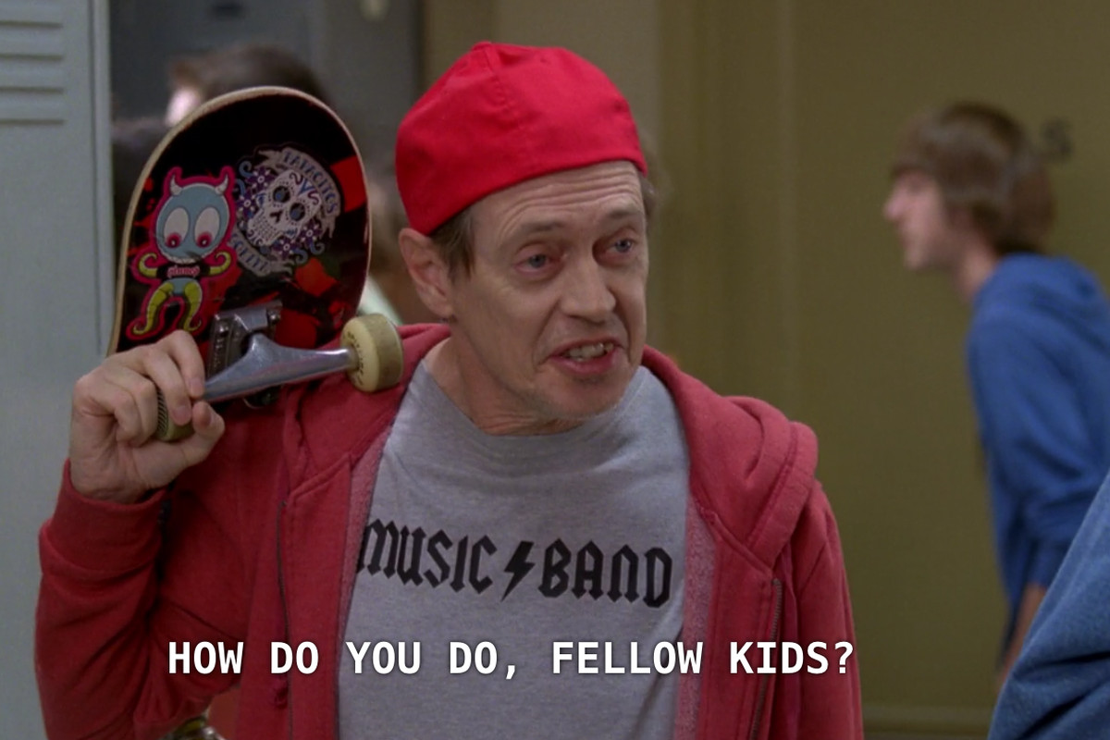
Suggestions for TikTok
Reached 1 Billion User mark in 2021 after 5 years - Most downloaded app globally in 2020
Platform being used as a search engine
Gives users the tools to create on the TikTok platform
Age group: 10 – 19 followed by 20 – 29 – Gen Z!
Profile Views - Important - Accumulated through viral content
Short videos only – max 30 seconds - capture users attention quicker - relatable, authentic and funny posts resonates with students

Slide 23
Suggestions for TikTok
Keep up to date with the latest trends - apply them to a DCU point of view
Advantages: Content can go viral quickly - utilise CapCut templates – highly engaged audience on this platform
Disadvantages: Trolling
Viral Content - Evergreen Content e.g. DCU Care & Connect Hub
Brands – Ryanair 2.2 million followers – use trends that relate to their brand

Slide 24
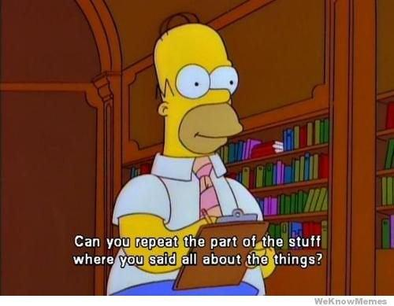
Any Questions?

