Slide 1

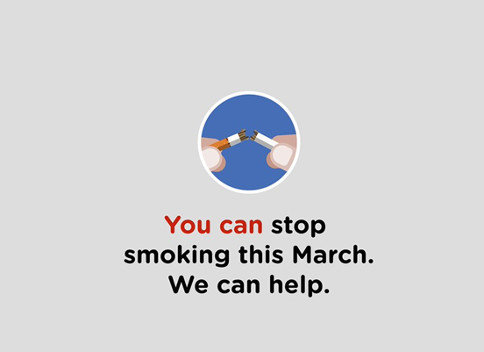

Get behind the QUIT Leaders
Partner information pack
March 2021

Slide 2
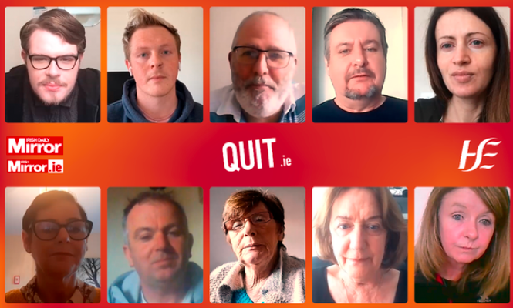
The partnership – Irish Mirror
Thousands of people give up smoking every year, but research shows that many smokers choose to go it alone when they quit. With support from the Quit programme, friends, family or even other quitters you have a much better chance of success.
To showcase the Quit services offered, how important support is and to encourage as many people to quit as possible this March, we have recruited 11 would-be quitters to tell their stories and help inspire others to join them on the journey towards becoming smoke-free.
Each of our Quit Leaders will follow their own personalised Quit Plan, with the goal of not smoking for 28 days and finally becoming completely smoke-free. The Quit Leaders are sharing their stories through twice weekly articles, videos and online updates in the Irish Daily Mirror and on irishmirror.ie. The content is also supported by homepage takeovers and social media promotion
Read about their quit attempts so far here
And watch their videos here
.
.

Slide 3


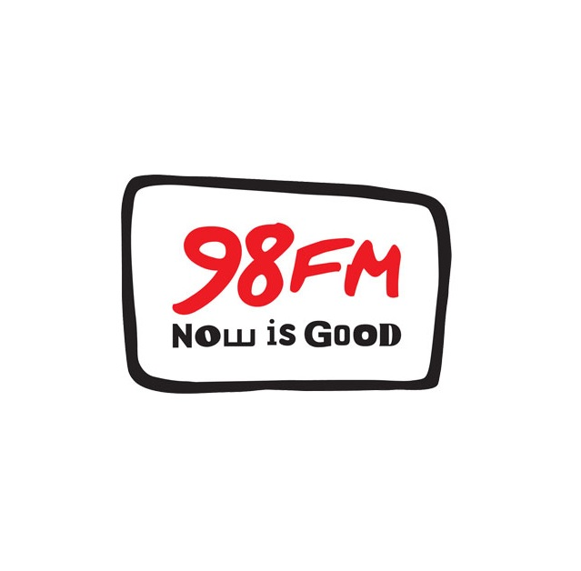



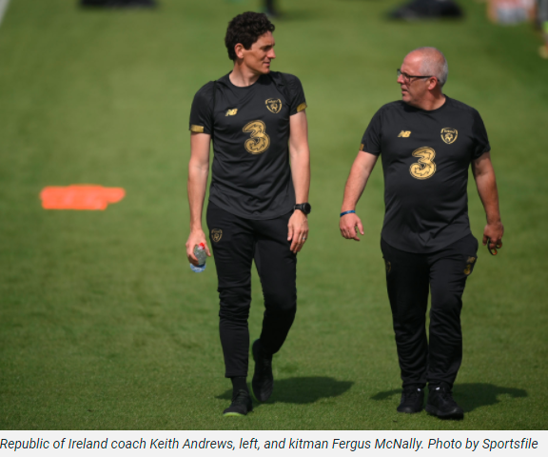
The partnership– Media Central
A collaborative and multiplatform partnership across several local and national radio stations amplifies our Quit Leaders and their journeys.
The Quit Leaders carried out interviews for each station and throughout March snippets of their interviews are played to give listeners tips, advice and their experience of quitting smoking so far.
Quit Leader: Fergus McNally
The Republic of Ireland soccer team’s kitman, Fergus McNally, will join Off The Ball AM every Wednesday in March to detail his quit attempt, talk about the support he is receiving from the Quit service and why this time he plans to stay off the cigarettes for good.
Follow his progress here

Slide 4
March Quit Month 2021
Our QUIT leaders are taking part in QUIT month, our drive to encourage people to make March their last stop by quitting smoking for 28 days. People who smoke can start their quit journey at any point in the month
Other campaign elements
TV and radio
Throughout March we are on-air through TV, video on demand, radio and digital audio advertising. You can see the TV ad here and listen to the radio ad here
Digital advertising
Our digital display advertising is always on. We advertise on sites where our target audience go for news, current affairs and sports updates.
Social
From mid-February, we have encouraged people to prepare to quit by engaging with the Quit Service and getting prepared to make March their last stop.
Throughout March, we are sharing tips and advice to help our audience beat cravings and stay motivated.
Follow us on Facebook

Slide 5
Why is now a good time to quit?
There has never been a more important time to quit smoking.
Research shows that smoking is a risk factor for coronavirus infection.
Dr Paul Kavanagh, HSE Public Health Medicine Specialist, says: “Smoking increases your risk of acute respiratory infections like COVID-19 in a number of ways. Cigarette smoke damages the natural barriers in your airways and lungs to infections, dampens down your immunity and affects your breathing and circulation in a way that makes you vulnerable to severe illness and complications of infection.
COVID-19 is a new disease and we are learning a lot about its effects. Even at this early stage, available evidence points to smoking as a key factor leading to increased severity of disease and death in hospitalized COVID-19 patients. This is in addition to the already well-established and significant health risks of smoking. There is always good reason for people who smoke to quit, but there is no doubt that COVID-19 means this is now more important than ever’
While the majority of smokers in Ireland are between the ages of 24- 35, the Quit services are open to everyone and there are health benefits to quitting at any age. For instance, if you have smoked two packs of cigarettes a day for 40 years, you can quit with the right support. It doesn’t matter how old you are or how long you have been smoking, quitting smoking at any time greatly improves your health. When you quit, you are likely to add years to your life, breathe more easily, have more energy, and save money

Slide 6
Social media messaging
Key message | URL Links
Stop smoking for 28 days and you're five times more likely to quit for good. Make your next stop your last stop and visit quit.ie. #TheLastStop #QuitandWin | Link to 30 second TV ad on YouTube: https://www.youtube.com/watch?v=7cwWvPnhlHQ
Check in with the HSE Quit Leaders taking up the 28 day no smoking challenge this March #TheLastStop #QuitandWin | Link all videos on YouTube https://bit.ly/3bPXyHn
This year we're making March #TheLastStop and calling all smokers to start your journey to quit this month. Contact the Quit Line on freephone 1800 201 203 and double your chances of success — let's do this! 💪🏿💪🏼💪🏾 You can do this. We're here to help. #QuittingisWinning | http://www.quit.ie
Join #TheLastStop anytime by signing up to a free Quit Plan below or freephone the Quitline on 1800 201 203 for free tips and support. | https://www.quit.ie

Slide 7
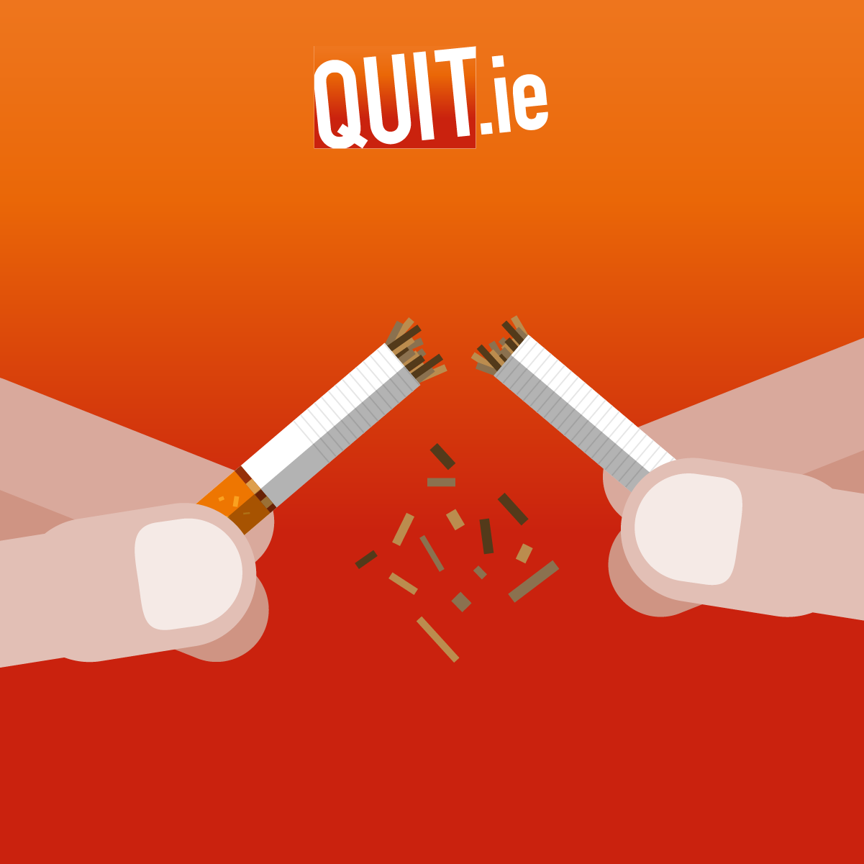
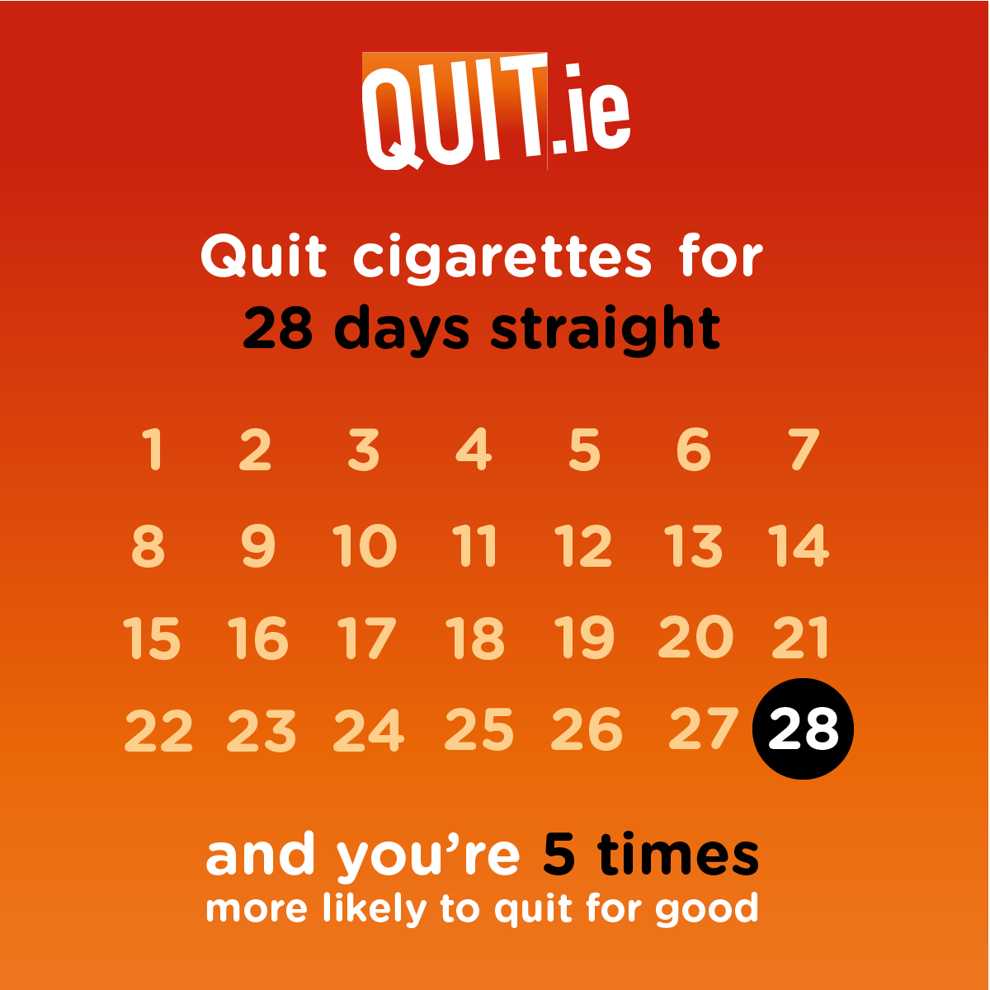
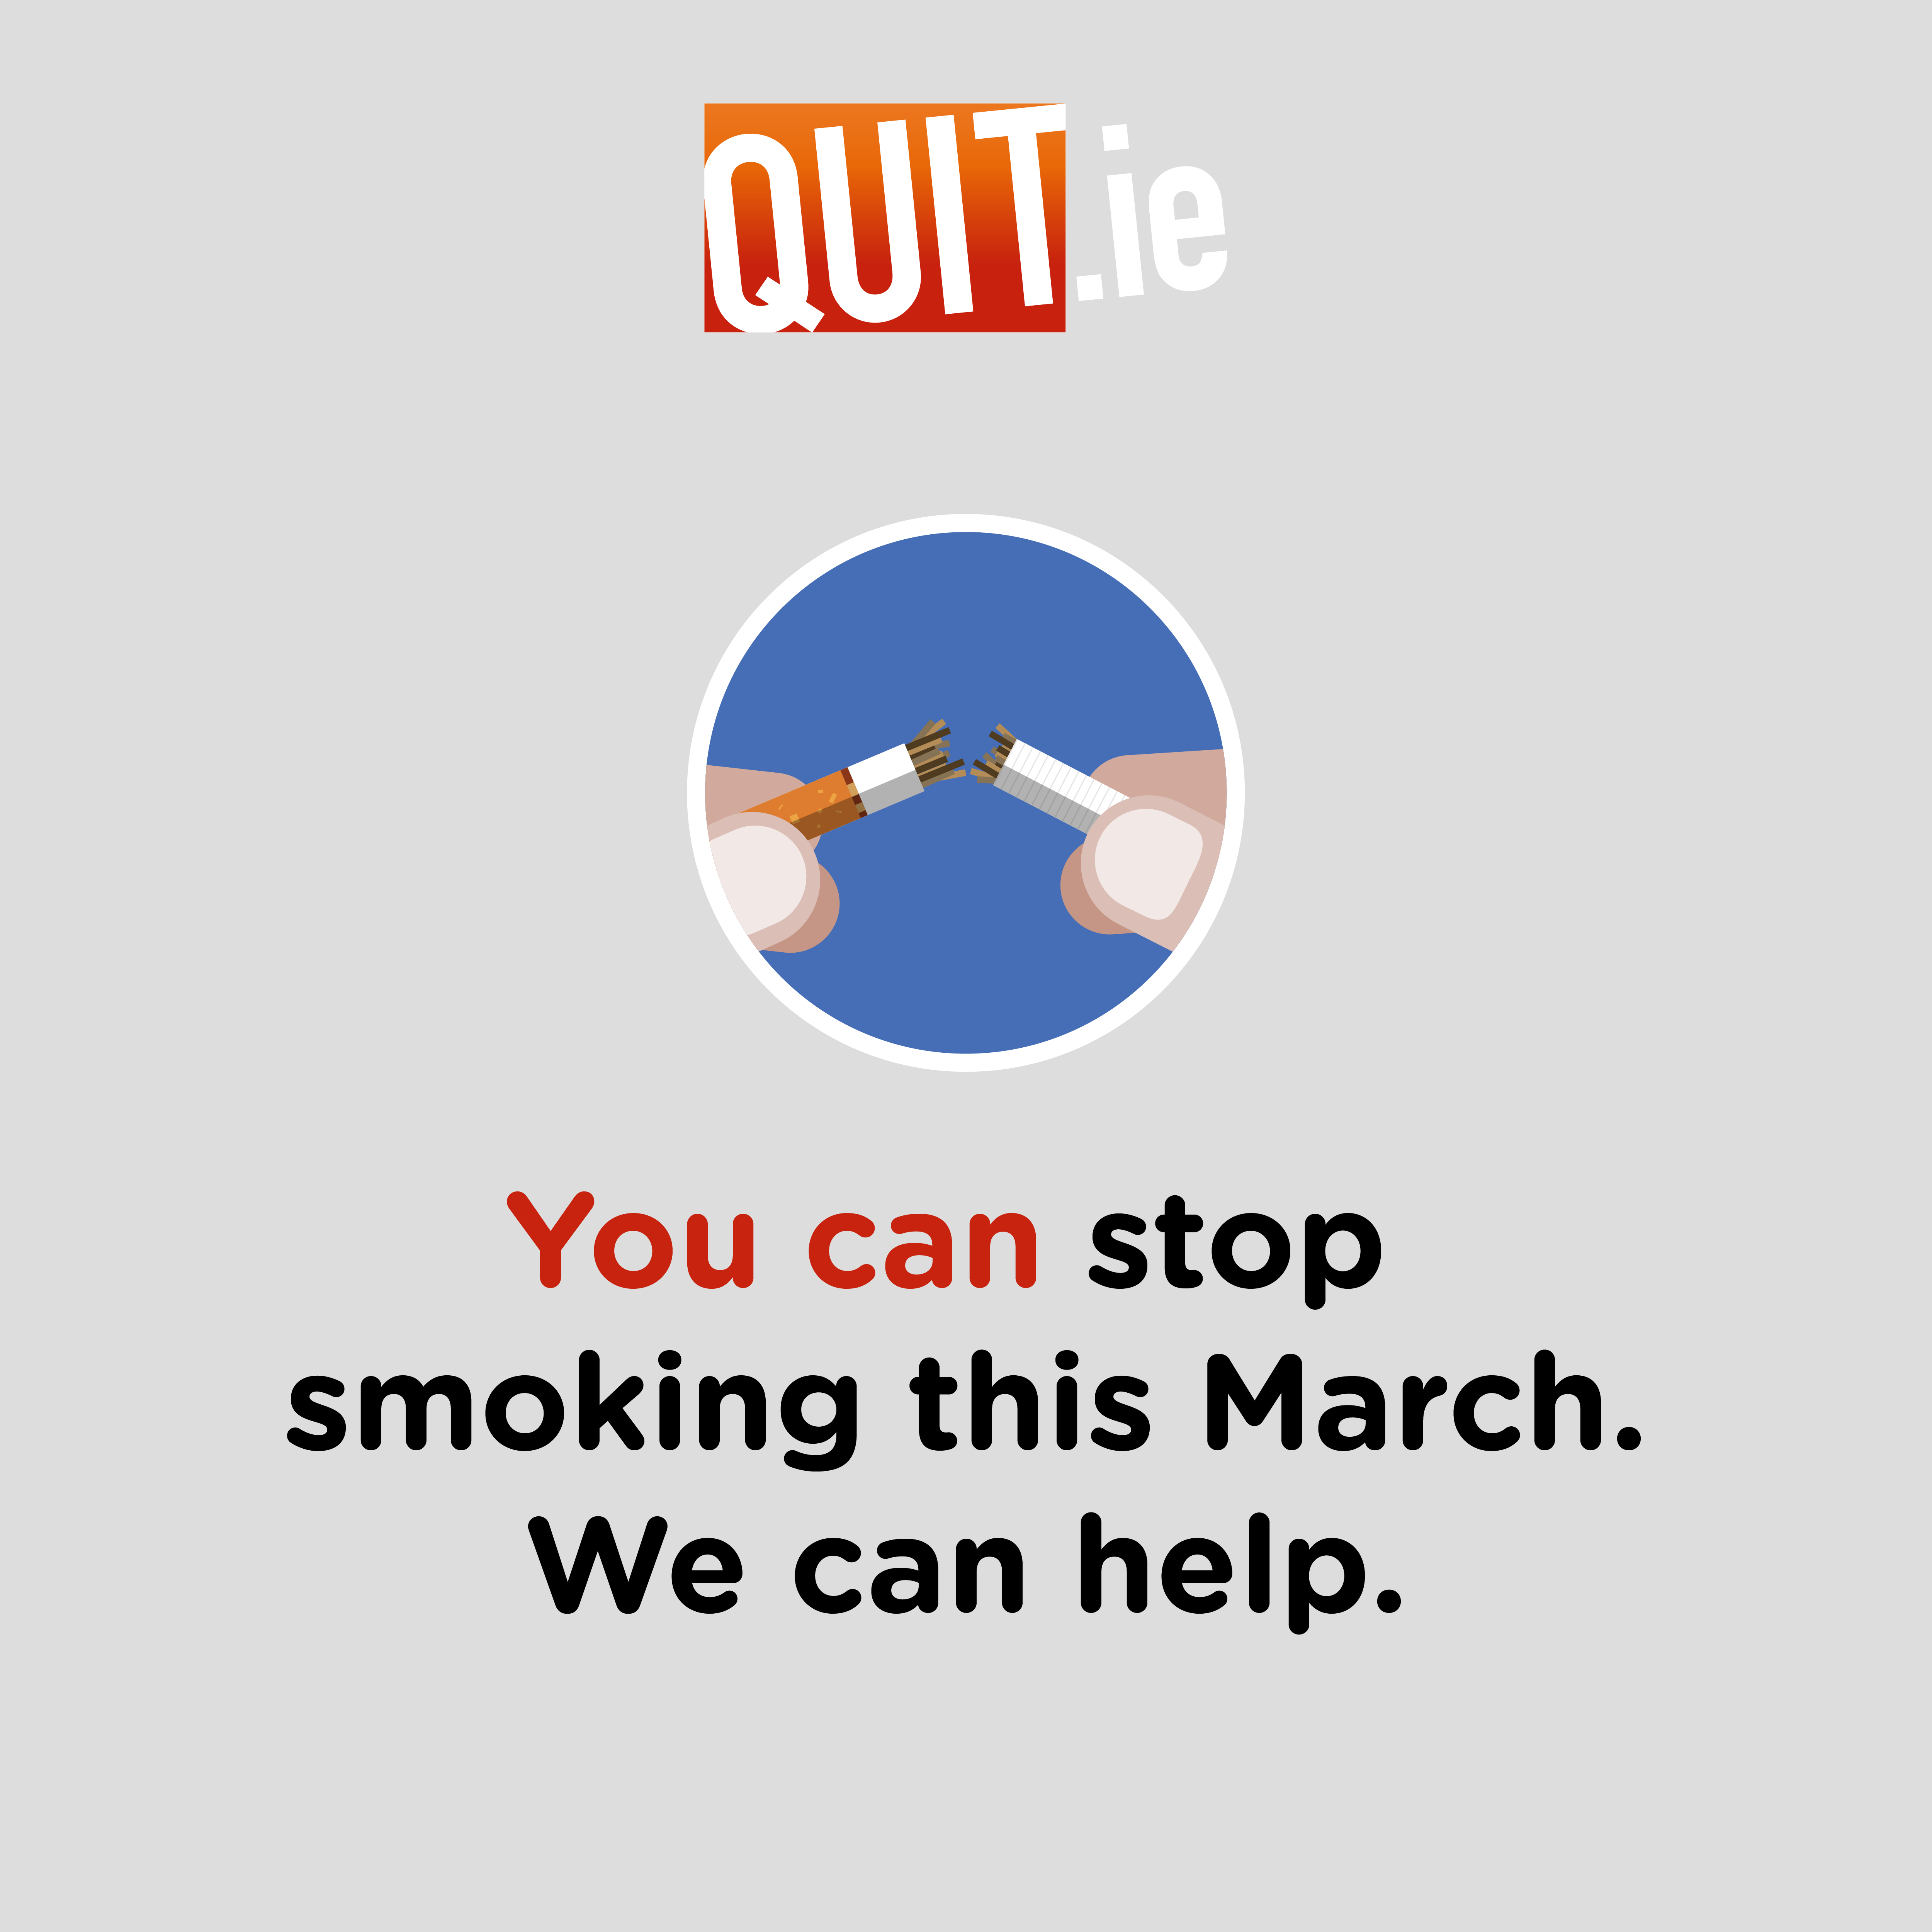
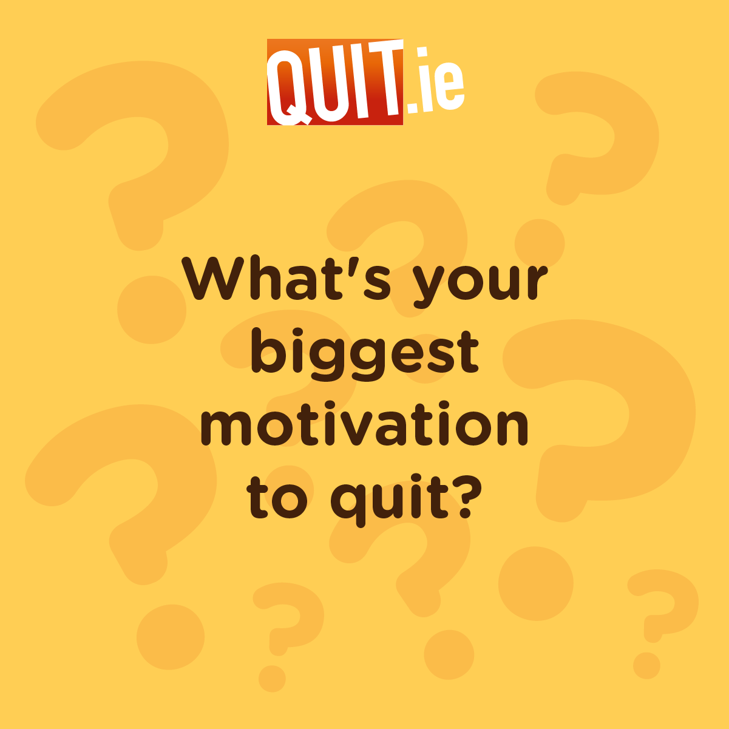
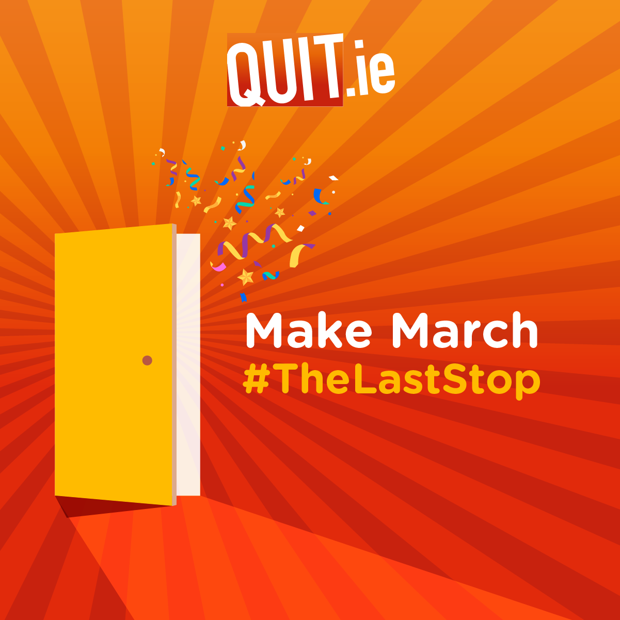
Images for social media
Twitter: @HSEQuitTeam
Facebook: https://www.facebook.com/HSEquit/
Instagram: hse_quit
Hashtag: #QuitandWin #TheLastStop

Slide 8
How can you help?
We really welcome your support in sharing our messages by posting content, tweeting or retweeting and engaging on your social media platforms.
If you are sharing the campaign messages, make sure you tag our social media accounts so that we can retweet and like your post.
We always need people who have quit to share their stories so that other people are encouraged to stop smoking. It really helps the campaign if you can share details of people who have quit and who may want to share their story or people who are planning on quitting and who might like to share their progress with others.
Thank you.
HSE campaign contacts
Campaign Manager – Darina Carr darina.carr@hse.ie
Campaign Director – Aghna Harte Aghna.Harte@hse.ie
Press queries – press@hse.ie
Social Media Executive- Thomas Fitzpatrick thomas.fitzpatrick@hse.ie

