Slide 1
Secretariat Report

Slide 2

Welcome
&
Meeting Expectations

Slide 3
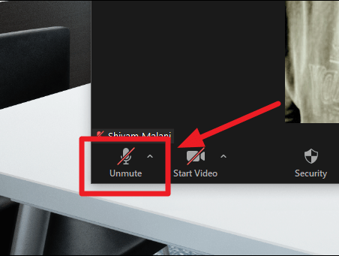

Slide 4
Agenda
7.10: Launch
Online Voting Information Session
Candidate’s
Presentation
PPN Handbook Review
Ratification of Handbook Review recommendations
8.00 Break
8.15 Information session on the Fingal on the PPN Strategic Plan Review
8.25 PPN Plenary Meeting:
Activity & Finance Report
Linkage Group Update
Plenary Session

Slide 5
Online Voting
This year we will hold our first online elections.
This will take place using electronic voting software.
Only your group’s nominated voters who attend the Plenary may cast a vote.
An email with a voting link attachment will be sent to your groups nominated voter.
The election will open 9 a.m. 25th June and close at midnight 25th June.

Slide 6
Candidates
Secretariat Candidates - Community Pillar
Anthony Ugbiyobo
Gareth Walsh
Yetunde Joyce
Samantha Dooley
Sean O’ Gormon
Sakinah Debola Abdul-Ibiyeye

Slide 7
Candidates
LCDC Candidates - Community Pillar
Anthony Ugbiyobo
Ian Lennon
Paularose McKenzie
Amaka Joyce Chuks
Audrey Wilhite

Slide 8
Candidates
LCDC Candidates – Social Pillar
Ayodele Yusuf
Geraldine Rooney
Raghu Nath

Slide 9
Deemed Elected
Secretariat
Alice Davis – Social Inclusion Seat
Hanumantha Rao Marepalli – Social Inclusion Seat
Stephanie Obijiaku – Social Inclusion Seat
Ian Croft – Environment Seat
Cathal J Copeland - Environment Seat
Gerald O’Halloran – Environment Deat

Slide 10
Deemed Elected
LCDC Candidate
Ann Lynch - Environment Seat

Slide 11
Background
Launched by the Department in November 2020.
Mandatory for every PPN to comply with
2+ year consultation process
Provides clarity and guidance on how PPNs should operate.

Slide 12
Programme
December 2020:
  The Secretariat decided to review the operations of the PPN against the mandatory requirements of the handbook and the best practice suggestions of the handbook.
January 2021:
  A working group was setup, an external facilitator was engaged and work commenced.

Slide 13
Approach
Assess PPN compliance with 39 mandatory requirements.
Assess 12 best practice guidance measures and identify what additional measures the PPN may wish to introduce.
Report on these findings with recommendations to the plenary.
Initial final report published in May and information meeting held for Plenary members.
Final draft published in June.

Slide 14
Outcome – Mandatory Requirements
Status | # | Note
Red | 0 | There are no serious deviations from the mandatory requirements.
Amber | 11 | There are minor or part deviations in some places.
Green | 28 | Full compliance with mandatory requirements in 71% of cases.
Each mandatory requirement assessed using the Traffic Light System.
Red: No serious contravention of the handbook exists that would be of concern to key stakeholders.
Amber: In most cases, there is a simple operational change required. In a few cases, minor amendments to the constitution are required. In some cases, the process exists, or existed, but is not currently active.
Green: No action required, PPN should continuously monitor to ensure active compliance.

Slide 15
Mandatory Sample Actions
Implement new Secretariat structure to include geographical seats.
Establish a quorum for the plenary.
Create a PPN Representative Journey framework – to ensure PPN Reps are supported as best as possible.
Re-establish the PPN Staff Liaison Committee.

Slide 16
Best Practice Sample Actions
Improve evaluation of PPN meetings and conduct annual survey with PPN members.
Roll out facilitator training to the Secretariat every two years.
Share best practice guidelines with committees with PPN Representatives.
Enhance FCC reporting on supporting the PPN.

Slide 17

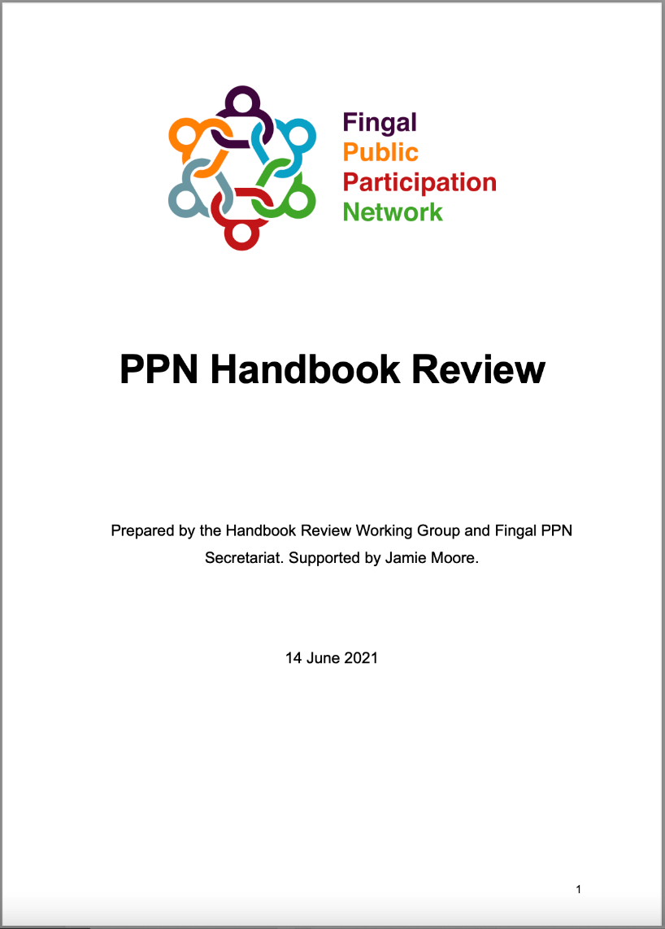
Questions in the chat box
&
Ratification by Zoom Poll

Slide 18

fdfdfd
Break
Please turn off your camera and audio for the duration of the break
See you back here at:
8.15pm

Slide 19
Review of PPN Strategic Plan
Angela Rogers

Slide 20
Background
Strategic Plan was published in 2018 and due to run to 2021.
17 actions across 4 goals.
A mid-term review was due in 2020. Not undertaken due to:
  COVID-19
  Staff Turnover
  Prioritising other aspects of PPN workload
  Imminent publication of PPN handbook (happened in Noember 2020)

Slide 21
Approach
Review commenced with the view to:
  Extending the implementation time by 1 year.
  Putting a plan in place to close out actions.
  Accounting for implications of the PPN Handbook Review recommendations.
  Any other emerging influences on the PPN.
  Updating membership profile.
  Surveying members on PPN operations.

Slide 22
Next Steps
Consider PPN Members survey responses
  Over 200 comments/suggestions received from 87 respondents.
Publish draft review in late June.
Information evening in early July.
Complete review by mid July.
Feedback to Plenary in November.

Slide 23
Plenary Meeting
Ema Idowu, Facilitator Fingal PPN Secretariat

Slide 24
Activity Report
Fingal PPN Secretariat

Slide 25
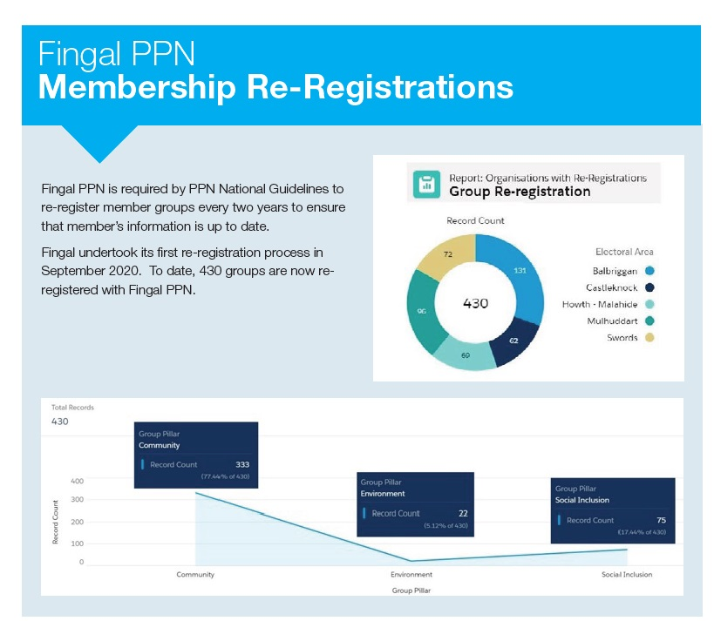

Slide 26


Slide 27

Strategic Plan was published in 2018 and due to run to 2021.
17 actions across 4 goals.
A mid-term review was due in 2020. Not undertaken due to:
  COVID-19
  Staff Turnover
  Prioritising other aspects of PPN workload
  Imminent publication of PPN handbook (happened in Noember 2020)

Slide 28
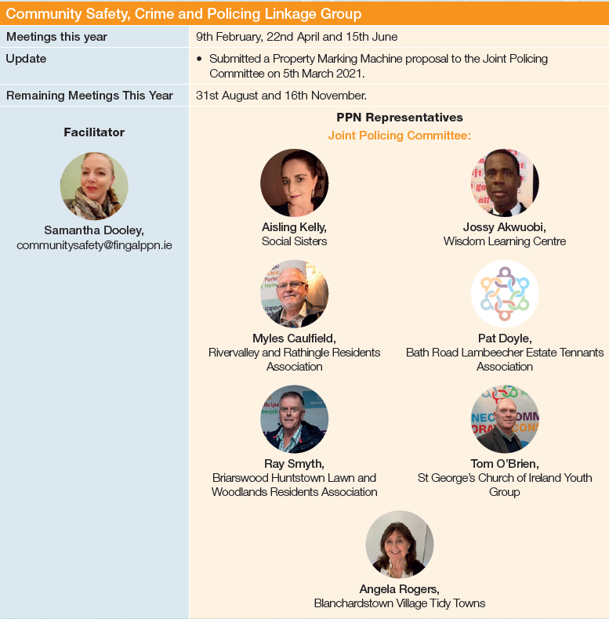
Linkage Group

Slide 29
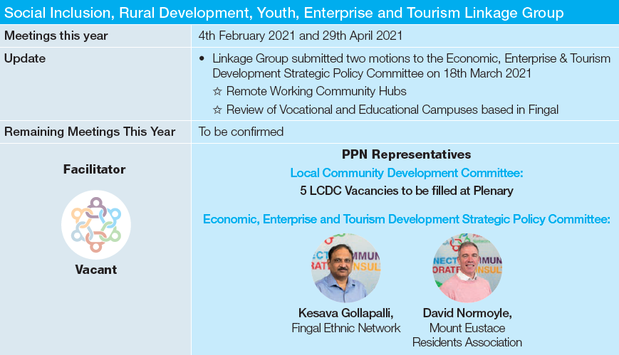
Linkage Group

Slide 30

Linkage Group

Slide 31
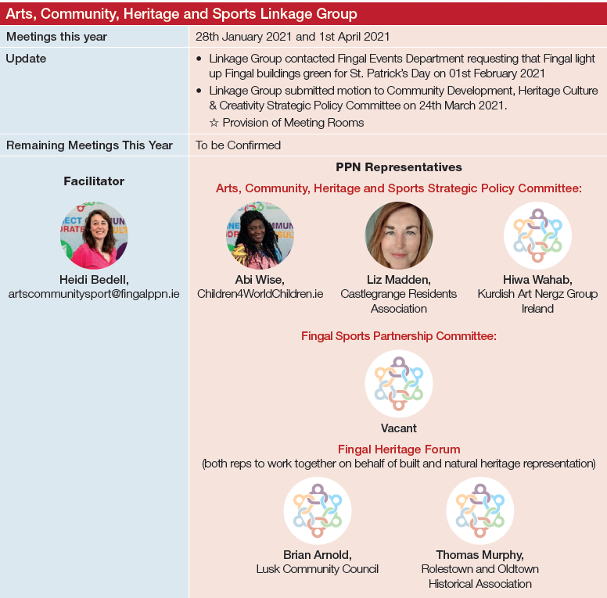
Linkage Group

Slide 32
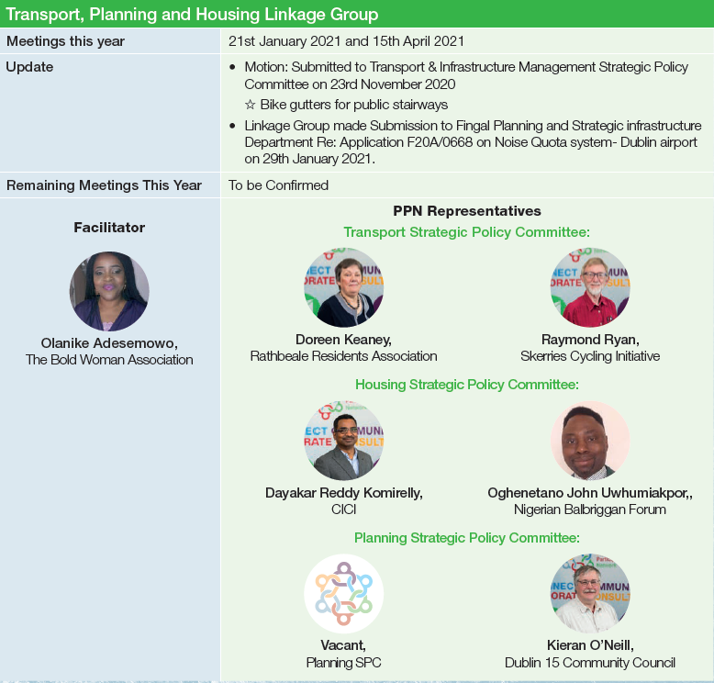
Linkage Group

Slide 33
Open Plenary Session
Interventions and Questions from Members

Slide 34
Close
We now bring the meeting to an end. We would like to thank you all for participating in this evening’s meeting.
Thank you, good night.
Anthony Brennan - Facilitator

Slide 35
Thank You
23rd June 2021

